Slide 1
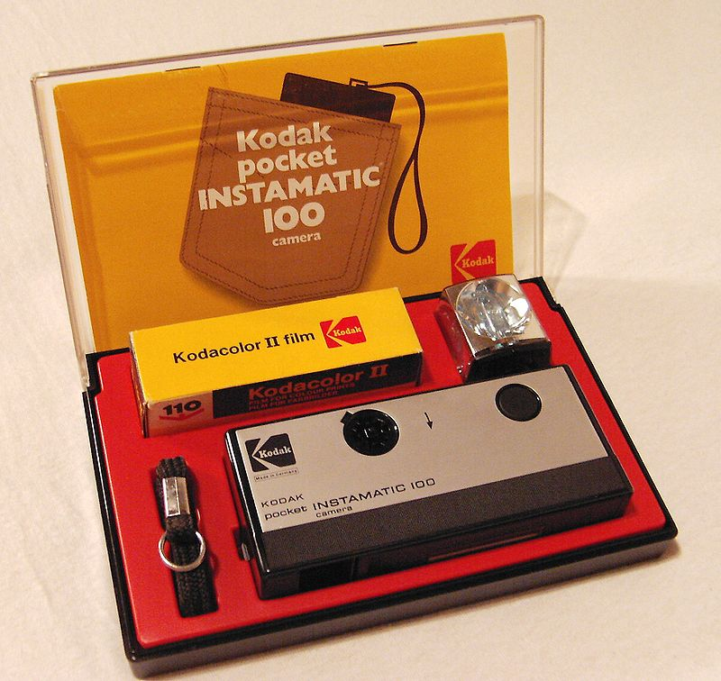

Slide 2
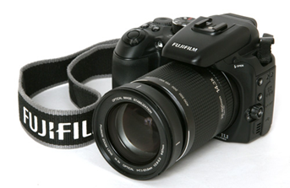
How can photography be used? Why and how is photography used?
Why and how is photography used?
Uses of photography
Photography
Education
Anti-bullying

Slide 3
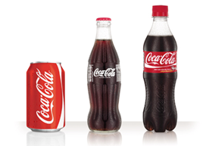
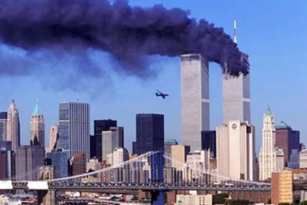
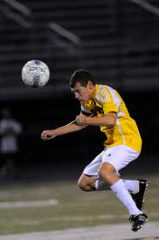
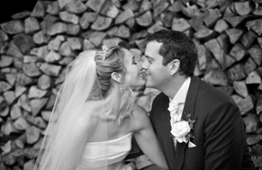
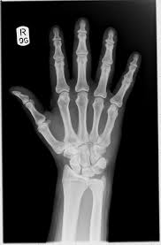
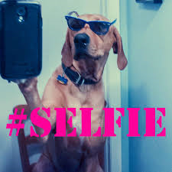
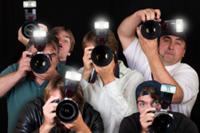
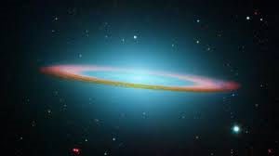
Promoting brands such as fashion labels
Educating about world events Protesting
Art
Journalism/ world news Documentary
Website promotion
Marriages, births, birthdays
Advertising
Medical
Education
Entertainment
Paparazzi
Musicians/ pop stars
Personal memories /social
Fashion
Political
Hobbies
Scientific research
Wildlife
Sports
Photography
X-RAYS
Medical research
Identification
Facebook/ twitter Instagram Selfie
Documenting historical events
Space NASA

Slide 5
RETWEETED OVER 500,000 TIMES IN THE FIRST 2 HOURS

Slide 7
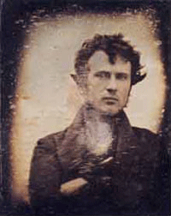
First ever selfie: Taken by Robert Cornelius in 1839

Slide 8
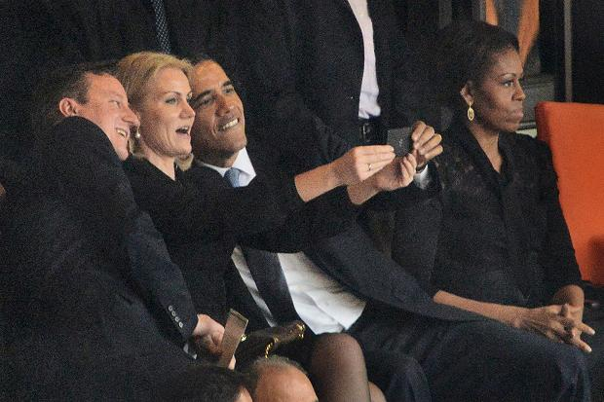
President Obama and David Cameron and Helle Thorning Schmidt enjoy the selfie

Slide 9
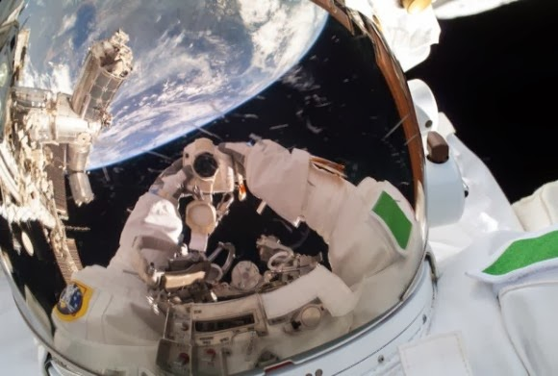
Apollo 12′s Pete Conrad is visible in the helmet of crewmate Al Bean during their moon landing in November 1969. Credit: NASA

Slide 10
586 million photos uploaded
in 2013

Slide 11
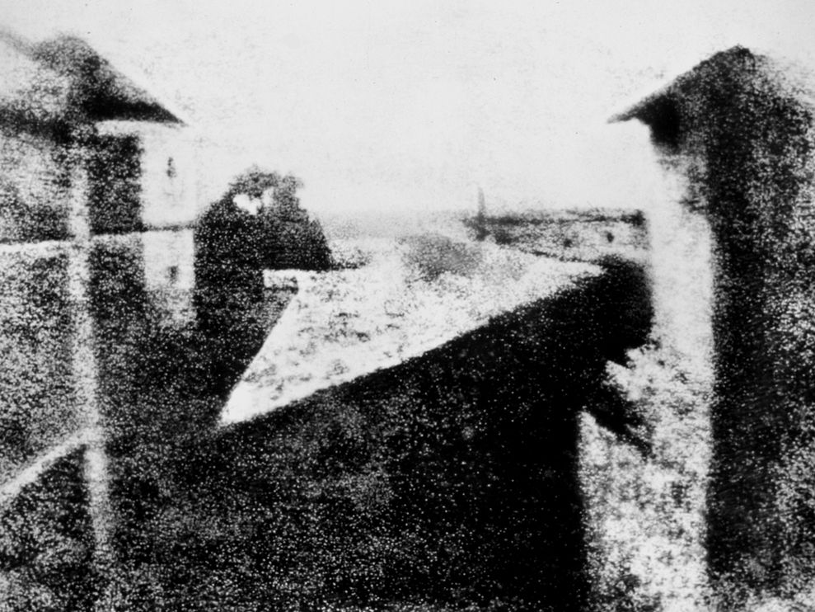
The world’s first photograph
Centuries of advances in chemistry and optics, including the invention of the camera obscura, set the stage for the world’s first photograph. In 1826, French scientist Joseph Nicéphore Niépce, took that photograph, titled View from the Window at Le Gras, at his family’s country home. Niépce produced his photo—a view of a courtyard and outbuildings seen from the house’s upstairs window—by exposing a bitumen-coated plate in a camera obscura for several hours on his windowsill.

Slide 13
What will be the photos that you remember? The images that will take you to a shared memory? Think pair share 3 minutes

Slide 16
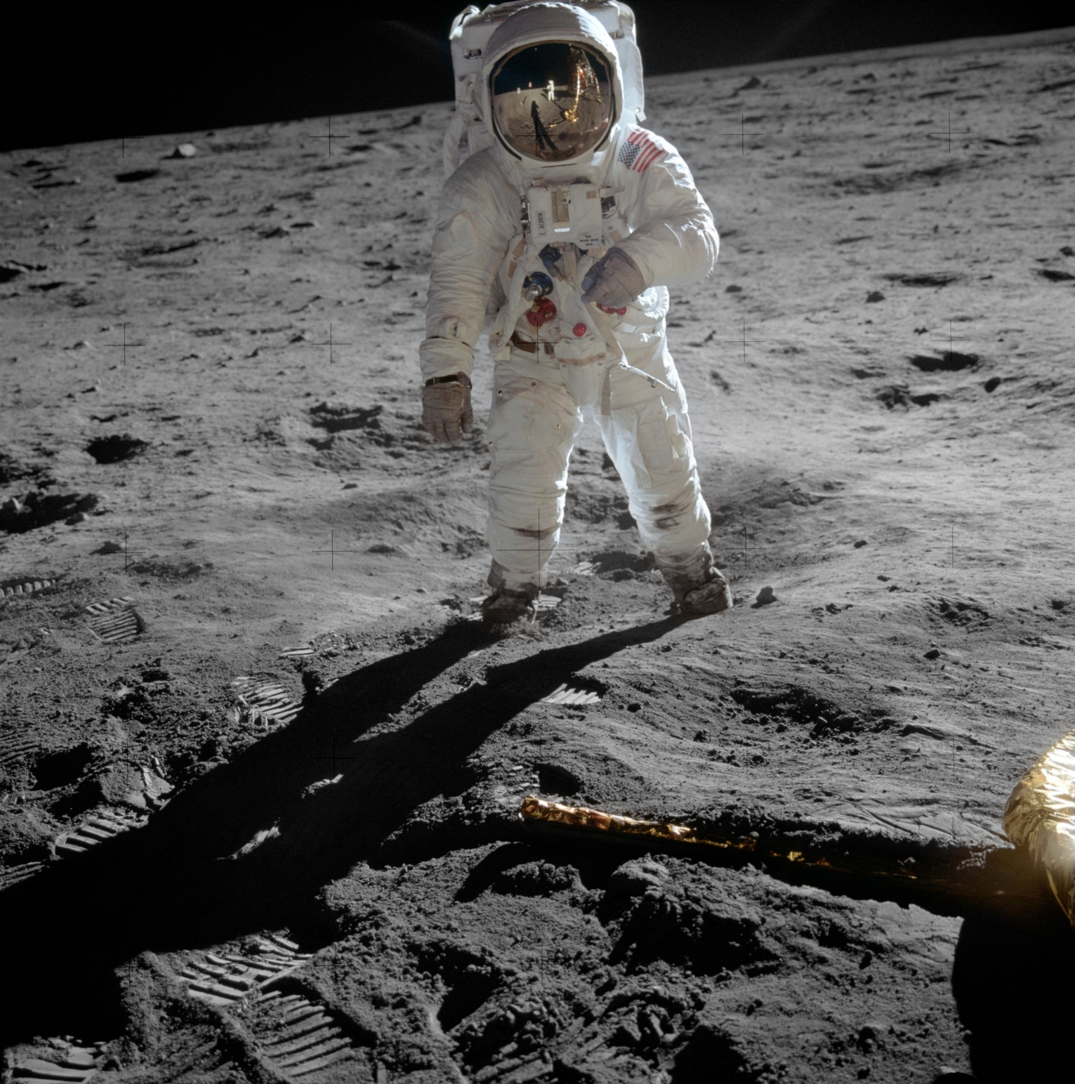

Slide 17
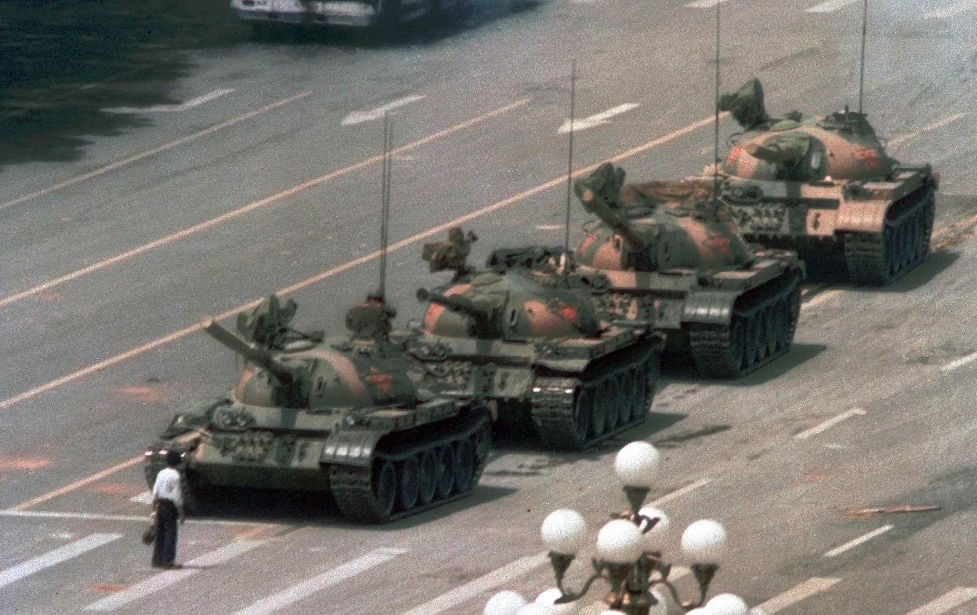
Tiananmen Square massacre 1989

Slide 18
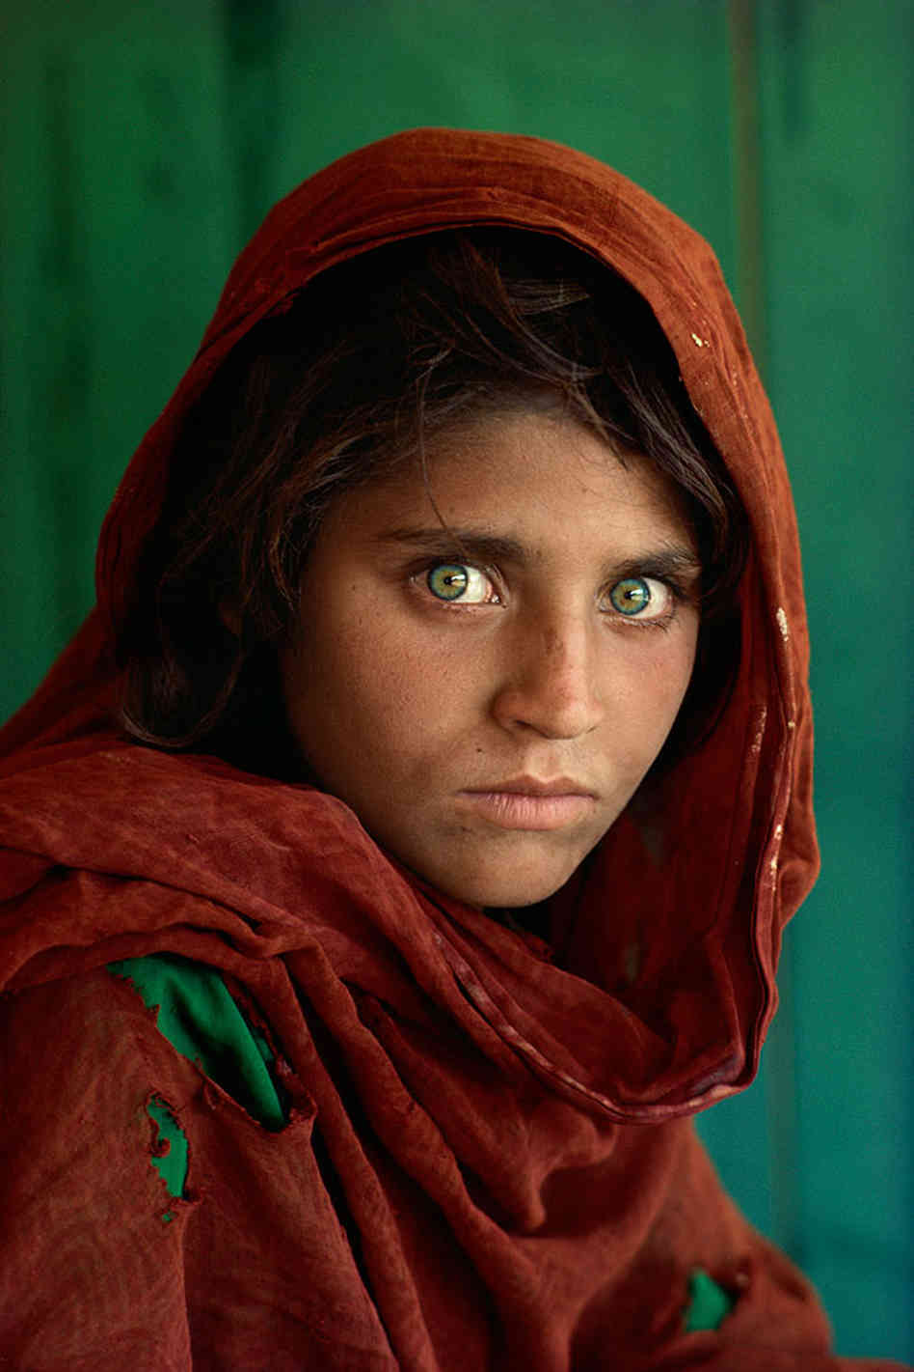
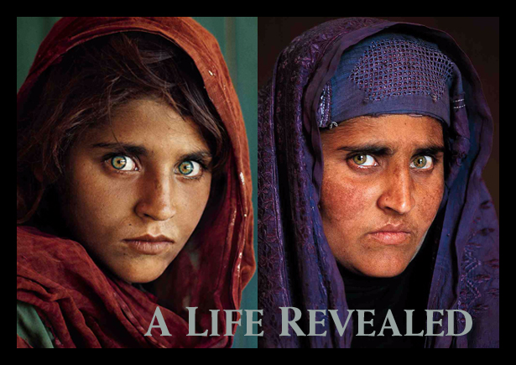
Afgan Girl : Steve McCurry 1985

Slide 19
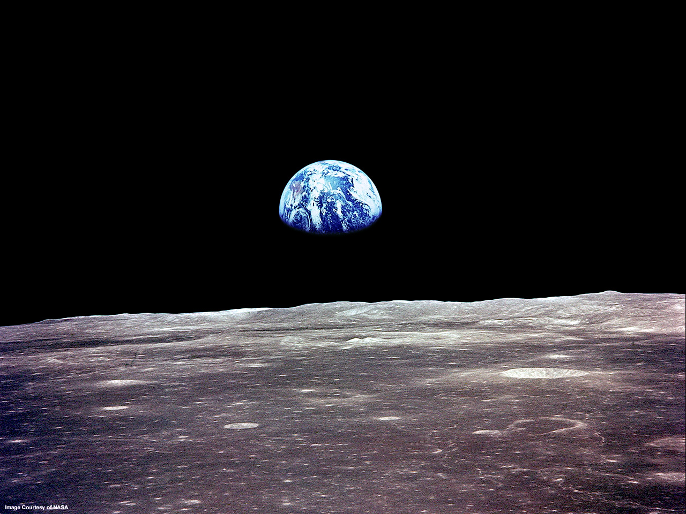

Slide 20
Your GCSE preparation starts today……
We will be learning the skills and techniques for you to achieve a high grade at GCSE.
If you miss a lesson or don’t complete homework you will get a lower grade at GCSE so I will be very strict about your homework.

Slide 21
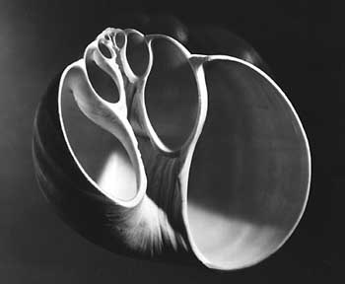
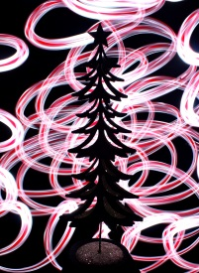
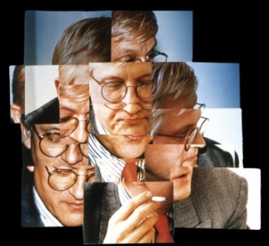
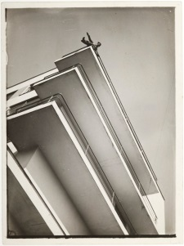
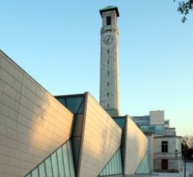
Laszlo Moholy-Nagy
KS4 Photography scheme of work overview
Year 9 (2016/2017) | Autumn Term |  | Spring Term |  | Summer Term
 | 6th Sept – 21st Oct 7 weeks | 31st Oct – 25th Nov 4 weeks | 28th Nov – 13th Jan 5 weeks | 16th Jan – 24th march 9 weeks | 27th March – 26th May 7 weeks | 5th June– 21st July 7 weeks
 | Natural Forms | Christmas card | Alphabet | Portraits | Edges | Poster design –Our City
 | Cyanotype Texture Depth of Field composition Colour Drawing into photos PS – levels, colour, cropping Contextual writing | composition lighting Light drawing PS – collage, layers, | Shape Texture Colour PS- cropping, levels, layers Contextual writing | Scanning Multiple portraits Joiners Shutter speed Drawing Post printing effects PS – ghosting, layers Contextual writing | Line Repetition PS- cropping, rotation, collage, colour Dyptich triptych Contextual writing | Using text composition Line Shape Purpose Drawing PS – layers, text, cropping Contextual writing
 | Anna Atkins Karl Blossfeldt |  | Kalle Mattsson | David Hockney Peter Zelewski | Jan Groover Laszlo Moholy-Nagy | Paul Grogan
 | Studio Southampton common School garden | Studio Home | Studio School Home graveyard | Studio home | School Local environment Southampton city centre | Southampton city centre

Slide 22
Lesson Objective :To be able to collate my research ideas and photographs
Create a new folder in your Large media file storage area – PHOTOGRAPHY
Within Photography create a folder NATURAL FORMS-
Using Weebly
Go to www students.weebly.com and log in with the log in username and password I will give you.
You can now start to build your website

Slide 23
Choose a theme. A dark background works best to show off your photos.

Slide 24
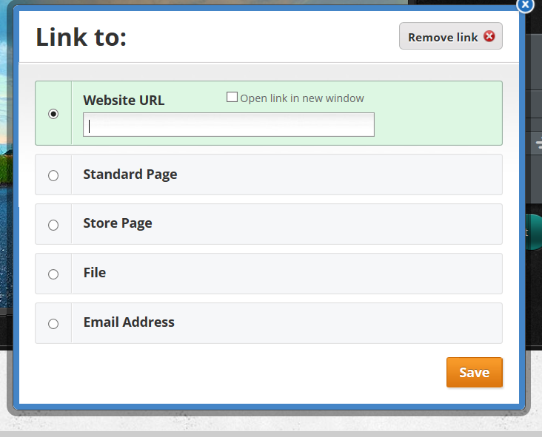
Click on button text.
Click on link
Type in http://ushyear9photography.weebly.com/
And Save

Slide 25
To build pages. Go to the pages and add standard pages and then rename pages so you have the following;
Home
Natural Forms
Christmas card
Alphabet
Portraits
Edges
Our City

Slide 26
Make the site yours by…
Adding your own photos as headers or background.
Insert a text box on the Home page and write about your interest in photography.
Create interesting titles for the Natural Forms page title.

Slide 28
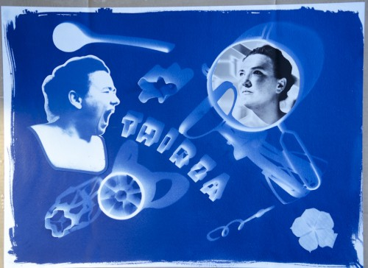
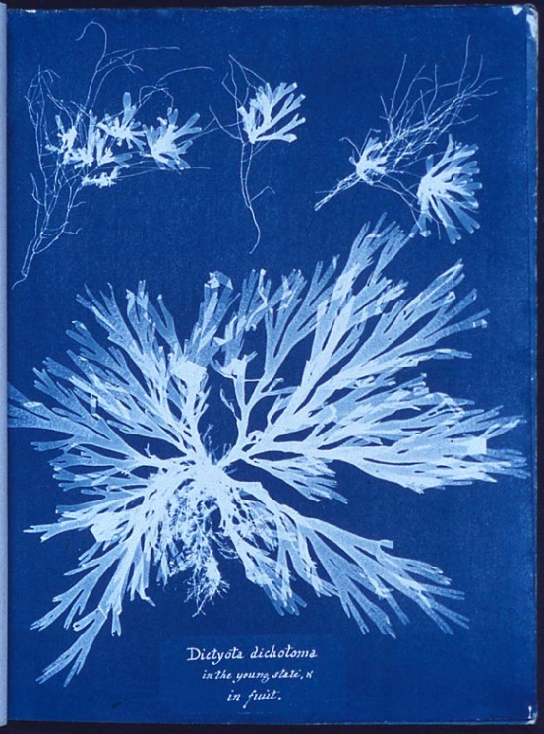
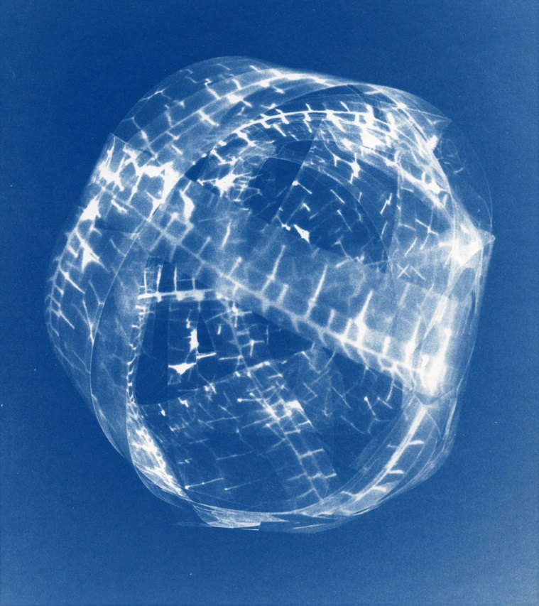
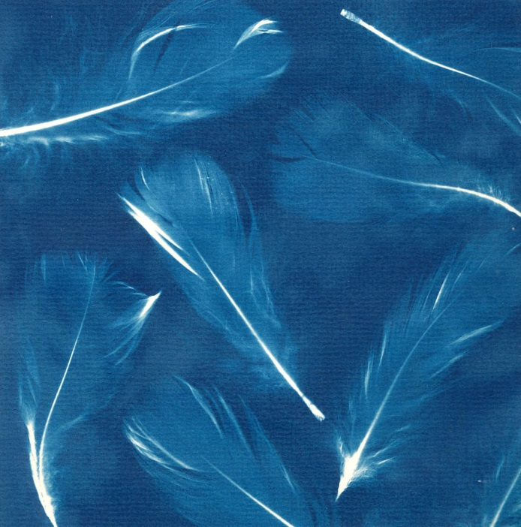
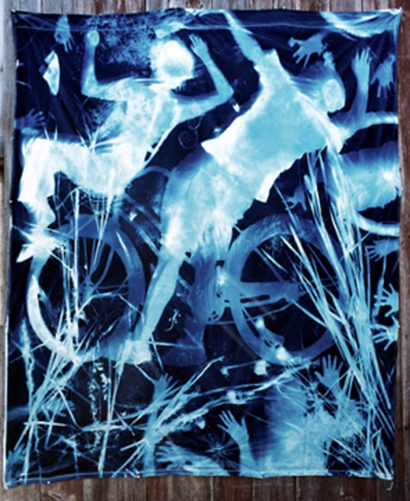
Learning Objective: To be able to explore and create with cyanotype techniques.
I am looking for:
A balanced composition
A variety of solid and translucent objects
A record of timings
A written evaluation of your work.

Slide 29
Homework 2 Anna Atkins
Homework 1
Collect and bring in some objects to use in your cyanotype on Friday. Try to have some solid and some transparent.
Collect 4 images of her Cyanotype images. Put these images on 1 slide of a power point.
Describe the process to make a cyanotype image. Put this in a 1 power point slide.
Email the slide to your school email – (usual log in @student.ushschool.org)
Due in ?? September

Slide 30
Homework 1 – Collecting objects
Bring in some objects to use in your cyanotype experiments on Friday 11th Sept. Try to find some solid and some transparent objects.
Homework 2 - Anna Atkins
Collect 4 images of her Cyanotype images. Put these images on 1 slide of a power point.
Describe the process to make a cyanotype image. Put this in a power point slide.
Email the ppoint to your school email – (usual log in @student.ushschool.org) or save in your area.
Due in 14th September
Homework 1 – Collecting objects
Bring in some objects to use in your cyanotype experiments on Friday 11th Sept. Try to find some solid and some transparent objects.
Homework 2 - Anna Atkins
Collect 4 images of her Cyanotype images. Put these images on 1 slide of a power point.
Describe the process to make a cyanotype image. Put this in a power point slide.
Email the ppoint to your school email – (usual log in @student.ushschool.org) or save in your area.
Due in 14th September
Homework 1 – Collecting objects
Bring in some objects to use in your cyanotype experiments on Friday 11th Sept. Try to find some solid and some transparent objects.
Homework 2 - Anna Atkins
Collect 4 images of her Cyanotype images. Put these images on 1 slide of a power point.
Describe the process to make a cyanotype image. Put this in a power point slide.
Email the ppoint to your school email – (usual log in @student.ushschool.org) or save in your area.
Due in 14th September
Homework 1 – Collecting objects
Bring in some objects to use in your cyanotype experiments on Friday 11th Sept. Try to find some solid and some transparent objects.
Homework 2 - Anna Atkins
Collect 4 images of her Cyanotype images. Put these images on 1 slide of a power point.
Describe the process to make a cyanotype image. Put this in a power point slide.
Email the ppoint to your school email – (usual log in @student.ushschool.org) or save in your area.
Due in 14th September

Slide 31
Homework
Make sure you have the homework slip
Search the internet for Karl Blossfeldt. Collect 4 images of his close up photographs of nature
Put this in a power point slide and email to yourself (your login@student.ushschool.org) or come after school to use a school laptop.
Underline the words on your key words in art sheet that describe Blossfeldt’s photography.
Due in Sept

Slide 32
Use as many of these photography words as you can
Art analysis word bank
Visual language – the top 10 things to talk about
Technique | Colour | Composition | Shape | Subject
Light | Media | Mood | Style | Story
Word Bank
Colour | Composition | Mood | Style | Light | Technique | Media
Blend Bright Clashing Cold Contrast Deep Dull Glowing Harmonious Intense Luminous Mixed Monochrome Opaque Pale Primary Pure Secondary Tone Translucent Transparent Vibrant Warm | Background Blurred Complex Confused Distance Eye line Focus Foreground Form Line Middle ground Movement Near Perspective Scale Shape Space Symmetry | Alive Atmospheric Calm Delicate Depressing Dignified Disturbing Fresh Exciting Flamboyant Expressive Humorous Imposing Nostalgic Sad Sentimental Tranquil | Abstract Derivative Distorted Emotional Exaggerated Exterior Fake Fantasy Figurative Impressionistic Landscape Religious Representational Still life Sketch Surreal Symbolic | Artificial Contrast Dark Evening Fierce Gentle Harsh Hazy Intense Natural Shady Shadowy Warm | Palette knife Drawn 2 dimensional 3 dimensional Texture Shading Mark-making Impasto Tone Underpainting Overpainting Cross hatching Stippling Scumbling Hatching Layered Linear Continuous line Scratch Spray Resist Stencil Manipulation Scribble | Textile Collage Print Photograph Computer generated Pencil Ink Mixed media Installation Sculpture Paint Charcoal Graphite Acrylic Watercolour Stitch Pastel Chalk Felt pen Fine liner Biro Bleach Photoshop

Slide 33
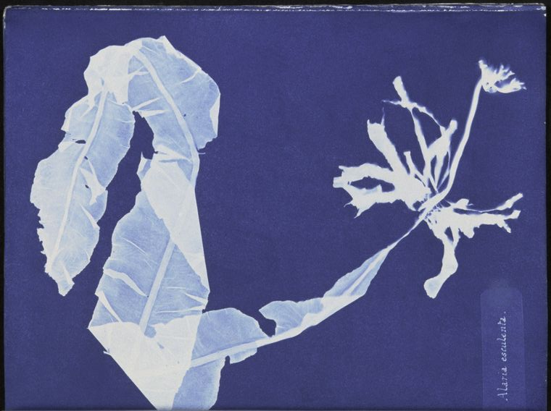
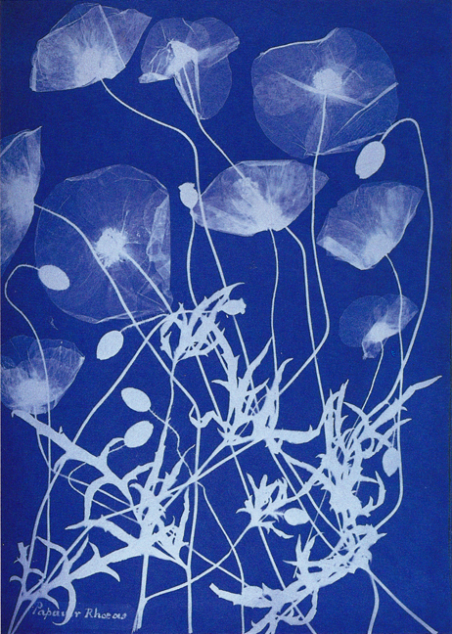
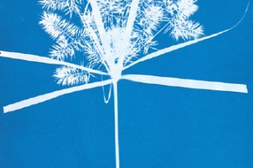
To be able to comment on the work of Anna Atkins
Click on 1 of your Atkins images, right click and save as a picture, call it Atkins 1 in your large media file store , still life. Repeat this for the other images, call ing them 2 – 4.
On your weebly site create a title Anna Atkins, drag in a slide show and upload the four images
Upload your description of making a cyanotype – Add a text box to weebly and copy and paste your words from your homework.

Slide 34
To be able to comment on the work of Anna Atkins
What information about Anna Atkins will help you become a better photographer?
Her inspiration
Her techniques
Her subject
What was happening at the same time
Insert a text box on weebly
Describe when and how Anna Atkins worked. Use these sentences to help you write about Anna Atkins along with the information sheet.

Slide 35
The cyanotype process was first used by Anna Atkins in her book British Algae: Cyanotype Impressions in 1843. Anna Atkins used this technique of exposing treated paper to sunlight to form an image after meeting Fox-Talbot, a pioneer of early photography. Her neighbour Sir John Herschel discovered that a solution of iron salt could be exposed to UV light to make an image. Herschel named this process Cyanotype after the blue colour. Anna combined these two discoveries to create her cyanotype images which captured the details and structures of plants and flowers.
The cyanotype process was first used by Anna Atkins in her book British Algae: Cyanotype Impressions in 1843. Anna Atkins used this technique of exposing treated paper to sunlight to form an image after meeting Fox-Talbot, a pioneer of early photography. Her neighbour Sir John Herschel discovered that a solution of iron salt could be exposed to UV light to make an image. Herschel named this process Cyanotype after the blue colour. Anna combined these two discoveries to create her cyanotype images which captured the details and structures of plants and flowers.
The cyanotype process was first used by Anna Atkins in her book British Algae: Cyanotype Impressions in 1843. Anna Atkins used this technique of exposing treated paper to sunlight to form an image after meeting Fox-Talbot, a pioneer of early photography. Her neighbour Sir John Herschel discovered that a solution of iron salt could be exposed to UV light to make an image. Herschel named this process Cyanotype after the blue colour. Anna combined these two discoveries to create her cyanotype images which captured the details and structures of plants and flowers.
The cyanotype process was first used by Anna Atkins in her book British Algae: Cyanotype Impressions in 1843. Anna Atkins used this technique of exposing treated paper to sunlight to form an image after meeting Fox-Talbot, a pioneer of early photography. Her neighbour Sir John Herschel discovered that a solution of iron salt could be exposed to UV light to make an image. Herschel named this process Cyanotype after the blue colour. Anna combined these two discoveries to create her cyanotype images which captured the details and structures of plants and flowers.

Slide 36
Learning Objective: To be able to explore and create with cyanotype techniques.
Open Weebly and create a title My Cyanotypes.
Drag in a gallery and upload your cyanotypes from POOL – Students- art- photography- Year 9- 9X – Cyanotypes.
Drag in a text box and write what went well in this process for you and what could be improved.
I have been successful because …
To improve I need to ….

Slide 37
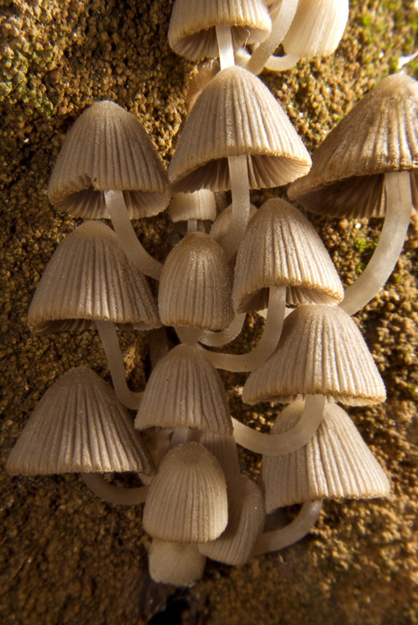
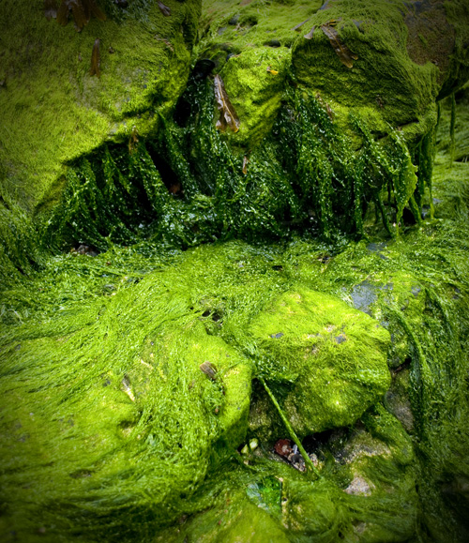
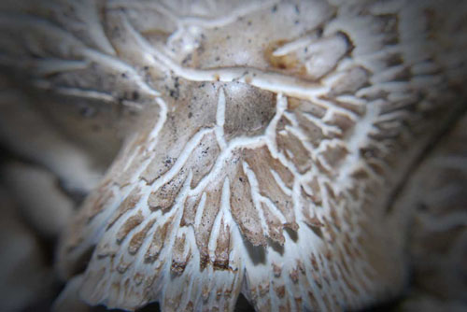
Texture
Photographs are physically flat, both on the screen and as a print. Texture is, by its nature, a tactile or physical quality. Run your fingers over a rough surface and you can feel its texture, run your fingers over a photograph of the same surface, and it is smooth.
Using texture in your photography can create the illusion of an additional engagement quality, by looking at your photograph the viewer is encouraged to imagine how it would feel to run their fingers over the subject. The more successful the illusion the more time the viewer spends looking at your photography.

Slide 38
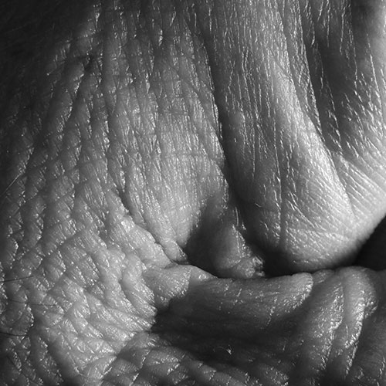
Revealing Texture
Texture in photography is generally revealed by directional lighting, that is, light that comes from one direction and creates shadows and highlights. Morning or evening light comes in from a low angle and casts long shadows that are perfect for revealing the textures.

Slide 39
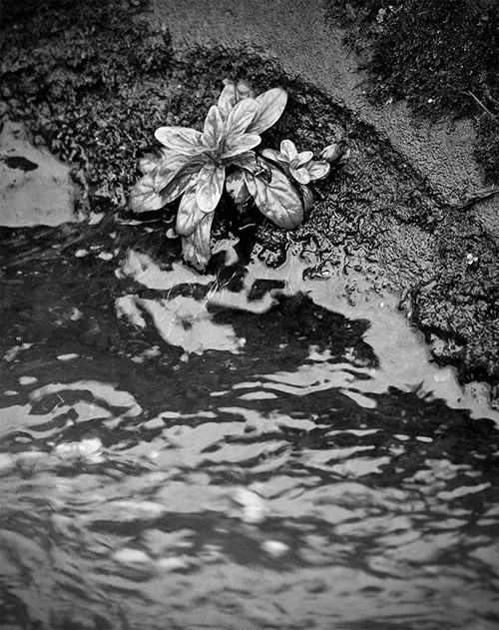
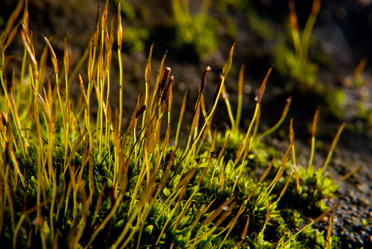
Nature
The bark of a tree, the surface of a rock, the grains of sand on a beach or the ridges and veins on a leaf.

Slide 40
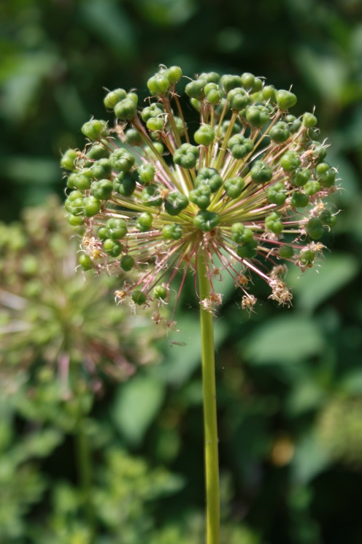
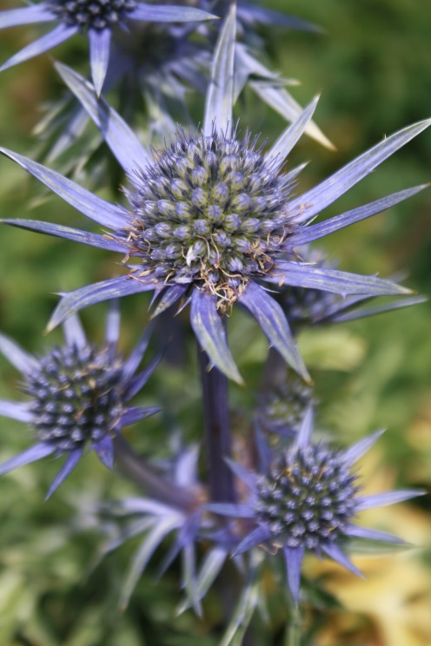
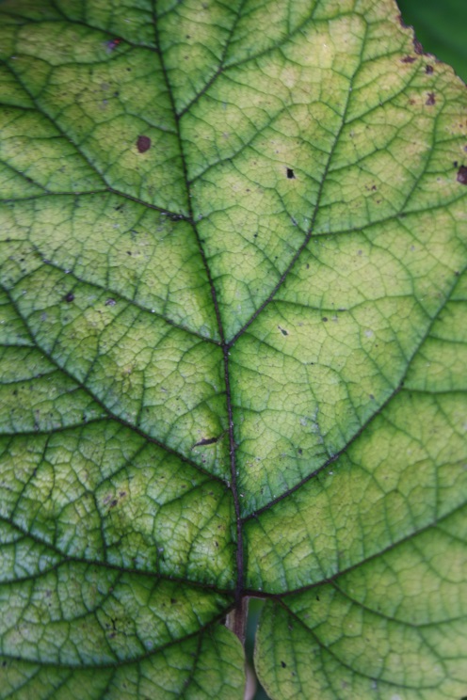
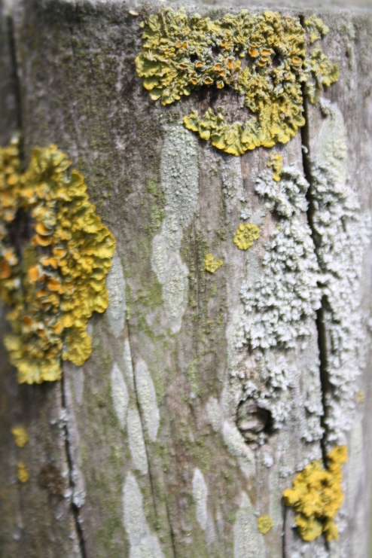
Research Activity
Learning Objective: To be able to describe texture using an image
You are to create a section of your weebly page dedicated to Texture and you are to include at least 8 research examples of natural texture. Your research page should clearly demonstrate the tactile quality of texture in photography. Save the images as pictures in your Natural Forms folder. Upload these as a gallery onto your weebly page.
Do not just choose the first images you find, look at a few and select ones that best describe texture.
Write a brief description in a text box on your weebly page of how the lighting reveals the texture.

Slide 41
Homework
Take at least 15 photos of textures in Nature.
Bring the SD card
Or email the photos to yourself
Due in 5th October

Slide 42
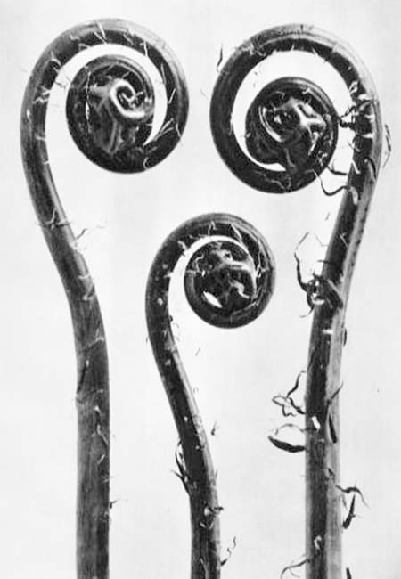
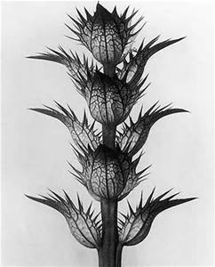
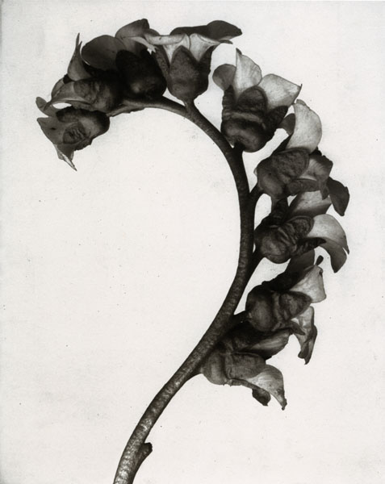
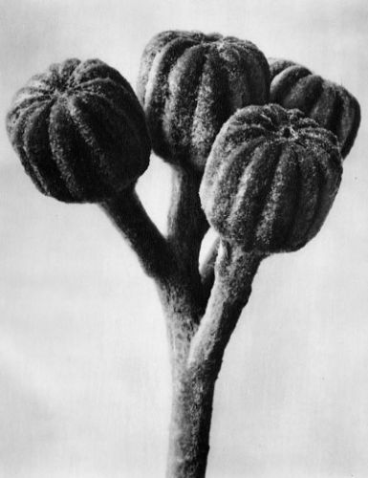
Karl Blossfeldt
composition
abstraction
contrast
spirals
Seed pods
emphasis
tone
monochrome
form

Slide 43
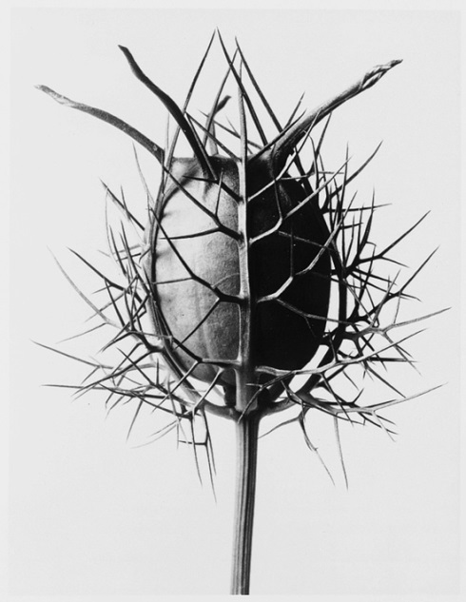
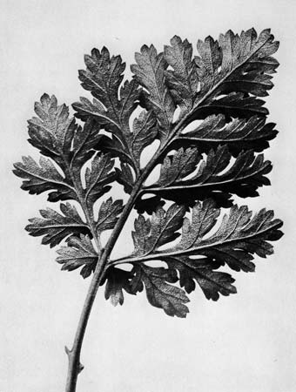
Learning Objective: To demonstrate the formal element of texture within nature
In the school garden, in the school grounds and within the studio are a whole variety of textures.
Take at least 20 photographs of textures in nature.
I am looking for:
A link to Karl Blossfeldt
All the photos to be in focus
Close cropping
Varied viewpoint
A variety of textures

Slide 44
Learning Objective: To be able to comment on the work of a photographer using key words and my opinion.
Write about Blossfeldt’s style and techniques. Use your eyes and the words you highlighted for your homework. Describe what you see and what you like either in your own words or using the sentence starters.
Click on 1 of your Blossfeldt images, right click and save as a picture, call it Blossfeldt 1 in your large media file store , still life. Repeat this for the other images, calling them 2 – 4.
On your weebly site create a title Karl Blossfeldt, drag in a slide show and upload the four images
Karl Blossfeldt’s photographs of nature captured the beauty of the delicate forms. He used monochrome with high contrast to emphasise the structures and shapes of the objects. He made abstract shapes by magnifying sections of shells and tree bark. His photographs were highly controlled and he used lighting to create shadows and highlights. I particularly like the spirals which he emphasised using strong contrasts. I will use this way of closing in on the structures in my own photography.

Slide 45
Karl Blossfeldt’s photographs of nature captured the beauty of delicate natural forms. The techniques he used were …
…………………………………………………………….
He controlled the photographs by using …………………………………………………………
By using high contrast he was able to emphasise ……………………………………………
I like this style because ………………………
I will use Blossfeldt’s style in my work by ………………………………………………………………
Karl Blossfeldt’s photographs of nature captured the beauty of delicate natural forms. The techniques he used were …
…………………………………………………………….
He controlled the photographs by using …………………………………………………………
By using high contrast he was able to emphasise ……………………………………………
I like this style because ………………………
I will use Blossfeldt’s style in my work by ………………………………………………………………
Use these words to complete the sentences
Use these words to complete the sentences
monochrome, lighting, high contrast, a studio setting, macro photography, symmetry, shapes, textures.
monochrome, lighting, high contrast, a studio setting, macro photography, symmetry, shapes, textures.

Slide 46
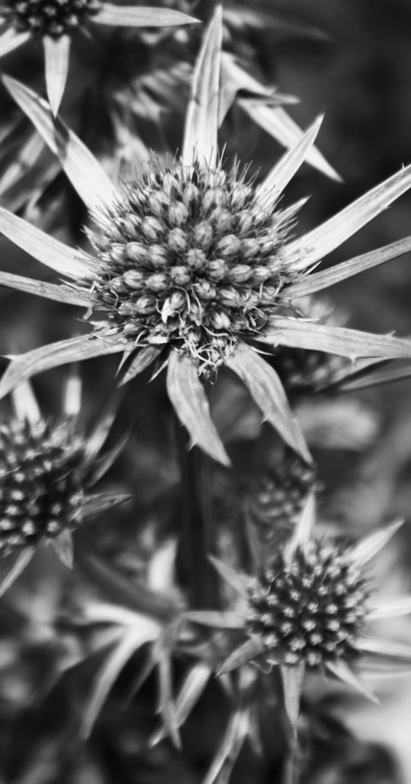
Learning Objective: To be able to edit and refine using photoshop.
Use photoshop to experiment with your best texture photos.
Use the following tools:
Levels
Cropping
Grayscale
Brightness/contrast
I am looking for:
A link to Karl Blossfeldt
Screenshots of the techniques you have used.
Written explanation of why you have changed your photo.

Slide 47
Learning Objective: To be able to present your ideas on your website
Checklist:
Cyanotype section
Textures in nature - homework
Karl Blossfeldt
Blossfeldt images
Blossfeldt written information
My response to Blossfeldt – all the photos you took on white backgrounds of opine cones etc.
Refining my response to Blossfeldt – your editing using photoshop showing each stage as separate images with written explanations of how and why you have changed each photo
Drawing into my Blossfeldt photos
Not completed yet
Depth of Field
Images that show changes in depth of field – homework
Using depth of field to change focus
Your experiment with written explanations of the camera settings
Photoshoot at Southampton Common
A gallery of all the photos you took
Refining my Common photos
Choose the best 4 photos and refine with editing. Show each stage with a written explanation.

Slide 48
Learning Objective: To be able to edit and refine using photoshop.
I am looking for:
A link to Karl Blossfeldt
Screenshots of the techniques you have used by putting them in a PPoint.
Written explanation of why you have changed your photo.

Slide 49
Learning Objective: To be able to evaluate my photographs against success criteria
Evaluate your best photo on your website:
I have been successful because …
To improve I need to …..
I am looking for:
A link to Karl Blossfeldt
All the photos to be in focus
Close cropping
Varied viewpoint
A variety of textures
I am looking for:
A link to Karl Blossfeldt
Screenshots of the techniques you have used.
Written explanation of why you have changed your photo.

Slide 50
Learning Objective: To be able to edit and refine a chosen image.
Make the image B&W. Use image adjustments/hue saturation / take the saturation down to nothing. Use the levels tool to increase the contrast.
Reverse the black and white – Image adjustments / invert.

Slide 51
Learning Objective: To be able to edit and refine a chosen image.
Draw into your photo by scratching away the black area on your printed photo.
I am looking for:
A link to Karl Blossfeldt
A creative approach
Accurate drawing skills
An interesting composition

Slide 53
Learning Objective: To be able to alter the depth of field to emphasize an area of a photograph
How can you control the amount of light that comes into your camera?
The aperture has a number to show it’s size (the focal length)
When the aperture changes it also effects how much of the photo is in focus.
Through the size of the hole that is inside the camera lens. This is called the aperture
Varying how long the hole that is inside the camera lens stays open. This is called the shutter speed

Slide 54
Learning Objective: To be able to alter the depth of field to emphasize an area of a photograph
This photographer has made the front mushrooms in focus and the background mushrooms out of focus

Slide 55
Learning Objective: To be able to alter the depth of field to emphasize an area of a photograph
Stick this in your book

Slide 56
Learning Objective: To be able to alter the depth of field to emphasize an area of a photograph
What is Depth of Field?
One important thing to remember here, the size of the aperture has a direct impact on the depth of field, which is the area of the image that appears sharp. A large f-number such as f/32, (which means a smaller aperture) will bring all foreground and background objects in focus, while a small f-number such as f/1.4 will isolate the foreground from the background by making the foreground objects sharp and the background blurry.
Image on left shot at f/2.8, Image on right shot at f/8.0
As you can see, just changing the aperture from f/2.8 to f/8.0 has a big effect on how much of WALL-E is in focus and how visible the background gets. If I had used a much smaller aperture such as f/32 in this shot, the background would be as visible as WALL-E

Slide 57
Learning Objective: To be able to alter the depth of field to emphasize an area of a photograph
In the above example, due to the shallow depth of field f2.8 , only one peg appears sharp, while everything else in the front and behind of that peg is blurred. This is because the depth of field in focus is small.
If I had used a smaller aperture, a bigger number f8, more of the photo would be in focus because the depth of field in focus is larger.

Slide 58
Learning Objective: To be able to alter the depth of field to emphasize an area of a photograph
2. Rotate until the back screen shows a low or high number
1.Change the setting dial to Av
3. Focus on the object you want in focus

Slide 59
Learning Objective: To be able to alter the depth of field to emphasize an area of a photograph
The lower the number the smaller the area in focus
1. Using the natural objects create a composition that you can show varied depth of field.
2. Take 4 photos of the same set up and record what camera setting you have used.
I am looking for:
A methodical approach
The focus to change in each image
Camera set to AV
F 4.5 and 1/60 shutter speed
Camera set to AV
F 29 and 1/10 shutter speed

Slide 60
Quiz
In your groups answer these questions. 5 achievement points for all correct answers
Name 2 ways you can vary the amount of light that comes into you camera?
What is the hole behind the camera lens called?
If the aperture is small what would the number be?
If the aperture is small would the shutter speed be fast or slow?
What setting on the camera dial do you use the change the aperture?
Aperture and shutter speed or the size of the hole and how long the hole is open
Aperture
F5.6
Slow
Av
Don’t forget your camera for our trip to the common on Wednesday

Slide 61
Homework
Find 3 examples of photographs of natural objects where depth of field has been used to focus on one area of an image.
Add these 3 photos to your website with a description of why you think the photographer focused on one area.
Remember to write down your log in details so you can go on your website at home.
User name:
Password:

Slide 62
Find 3 examples of photographs of natural objects where depth of field has been used to focus on one area of an image.
Add these 3 photos to your website with a description of why you think the photographer focused on one area.
Remember to write down your log in details so you can go on your website at home.
User name:
Password:
Due in 11th Oct
Find 3 examples of photographs of natural objects where depth of field has been used to focus on one area of an image.
Add these 3 photos to your website with a description of why you think the photographer focused on one area.
Remember to write down your log in details so you can go on your website at home.
User name:
Password:
Due in 11th Oct
Find 3 examples of photographs of natural objects where depth of field has been used to focus on one area of an image.
Add these 3 photos to your website with a description of why you think the photographer focused on one area.
Remember to write down your log in details so you can go on your website at home.
User name:
Password:
Due in 11th Oct
Find 3 examples of photographs of natural objects where depth of field has been used to focus on one area of an image.
Add these 3 photos to your website with a description of why you think the photographer focused on one area.
Remember to write down your log in details so you can go on your website at home.
User name:
Password:
Due in 11th Oct

Slide 63
Learning Objective: To be able to alter the depth of field to emphasize an area of a photograph
Present your photos on your website site.
Add text to each image with the camera settings
I am looking for:
A methodical approach
The focus to change in each image
An explanation of how and why you focused on different objects in the same set up.
Camera set to AV
F 4.5 and 1/60 shutter speed
Camera set to AV
F 29 and 1/10 shutter speed

Slide 64
Name 2 ways you can vary the amount of light that comes into you camera?
What is the hole behind the camera lens called?
If the aperture is small what would the number be?
If the aperture is small would the shutter speed be fast or slow?
What setting on the camera dial do you use the change the aperture?
Name 2 ways you can vary the amount of light that comes into you camera?
What is the hole behind the camera lens called?
If the aperture is small what would the number be?
If the aperture is small would the shutter speed be fast or slow?
What setting on the camera dial do you use the change the aperture?

Slide 65
Learning Objective: To be able to use the formal elements of texture, composition and focus to capture photographs of natural forms
Photoshoot in Southampton Common
Take at least 20 photos of natural forms in the common.
I am looking for:
Texture
Focus
Cropping
Detail
Remember – Look up down, from underneath, from above

Slide 66
Learning Objective: To be able to edit and refine using photoshop.
Use photoshop to experiment with your best texture photos.
Use the following tools:
Levels
Cropping
Grayscale
Brightness/contrast
I am looking for:
A link to Karl Blossfeldt,
Texture to emphasised
Screenshots of the techniques you have used.
Written explanation of why you have changed your photo.

Slide 67
Homework
Research Andy Goldsworthy. Collect 4 images of his sculptures of nature
Put this in a power point slide and email to yourself or bring on a memory stick or SD card or come after school to use a school laptop.
Underline the words on your key words in art sheet that describe his artwork.

Slide 68
Learning Objective: To be able to comment on the work of a photographer using key words and my opinion.
Write about Goldsworthy’s style and techniques. Use your eyes and the writing frame. Describe what you see and what you like.
Use the writing frame to help you.
Click on 1 of your Goldsworthy images, right click and save as a picture, call it Goldsworthy 1 in your large media file store , still life. Repeat this for the other images, calling them 2 – 4.
On your weebly site create a title Andy Goldsworthy, drag in a slide show and upload the four images
Andy Goldsworthy creates sculptures out of natural found objects such as leaves, stones and twigs. He makes them into beautiful structures often repeating shapes and patterns so your eye is drawn into the centre of the sculpture. He photographs his work to record his work as many of the sculptures are delicate and only last for hours or days. I particularly like the spirals which he emphasised using strong colours. I will use this way of creating shapes and patterns in my own photography.

Slide 69
Learning Objective: To be able to comment on the work of a photographer using key words and my opinion.
Photoshoot in Southampton Common or in the school grounds
In groups of 2 or 3 create 2 sculptures inspired by Andy Goldsworthy.
Photograph the sculpture.
Upload the photos onto your website.
I am looking for:
A link to Andy Goldsworthy,
Shapes that are repeated
Colour to be used to make patterns
Clear photographs taken from above – you will have to stand right over the sculpture.

Slide 70
Half Term homework.
Take at least 20 photograph of objects that are personal to you.
For example:
Objects that you use everyday – toothbrush, hairbrush, make up, clothes
Objects that are special to you – trophies, family heirloom, keepsakes from your childhood

