Slide 1
Your GCSE starts today……
60% Coursework - which is from your classwork and homework throughout Yr 10 and the first term of Yr11.
If you miss a lesson or don’t complete homework you will get a lower grade
40% is a project set by the exam board which is in Term 2 and 2 weeks of Term 3 of Yr11.

Slide 2
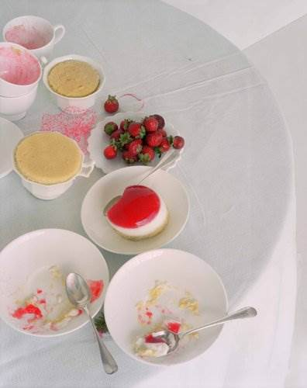
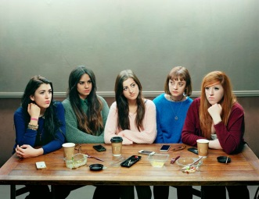
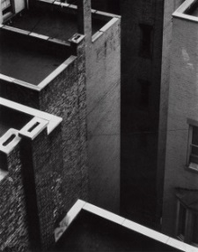
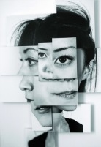
KS4 Photography scheme of work overview
Year 10/11 (2016/2017) | Autumn Term |  | Spring Term |  | Summer Term
 | Formal Elements- Colour, Texture, Light, Shape, Line, Composition, Focus |  | Identity Yr 10 exam 17th June
 | Shape - Still Life | Line, Composition- Architecture
 | Composition Depth of field Cropping/macro Colour PS – levels, cropping, Drawing Contextual writing | Rule of thirds Line Texture Depth of field PS- cropping, layering. Collage Drawing Contextual writing | Lighting Text Collage PS- Ghosting, text, layers, cropping, automate Double exposure Embellishment Drawing Contextual writing
 | Andreas Feininger Victor Schrager Laura Letinsky | Henri Cartier Bresson Paul Strand Cassio Vasconcellos | Taylor Wessing portrait prize David Stuart Rankin Nina Chakrabarti | Student choice

Slide 3
Assessment
AO1 – 20 marks
Develop your ideas through investigations informed by contextual and other sources demonstrating analytical and cultural understanding.
Student speak:
Use existing work of photographers and artists to give you ideas for your own work. Be able to talk about, recreate and develop their work showing you understand what the photographer has tried to do.

Slide 4
AO2 – 20 marks
Refine your ideas through experimenting and selecting appropriate resources, media, materials, techniques and processes.
Student speak:
Use the right techniques for the experiments you need to do. Keep going over your ideas until you get it just right. Show how your ideas have changed.

Slide 5
AO3 – 20 marks
Record ideas, observations and insights relevant to your intentions in visual and/or other forms.
Student speak:
Collect ideas about the theme. Record those ideas in word and images. Take a wide range of starting points and plan your first photoshoot.

Slide 6
AO4 – 20 marks
Present a personal, informed and meaningful response demonstrating analytical and critical understanding, realizing intentions and making connections between visual or other elements
Student speak:
Present a final piece that shows links to all you preparation work. You will be able to see the influence of other photographers and that you have changed and improved your work making it personal and unique.

Slide 7
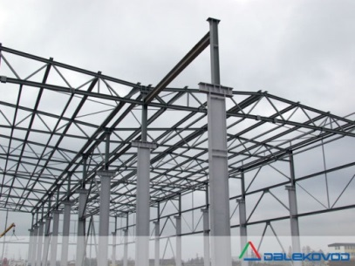
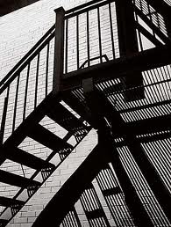
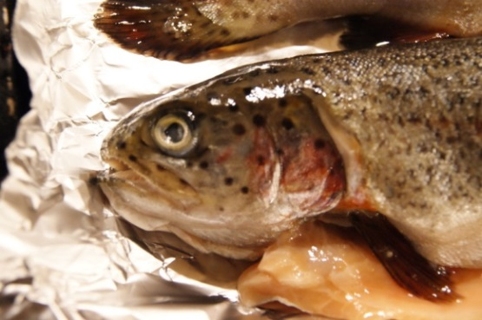
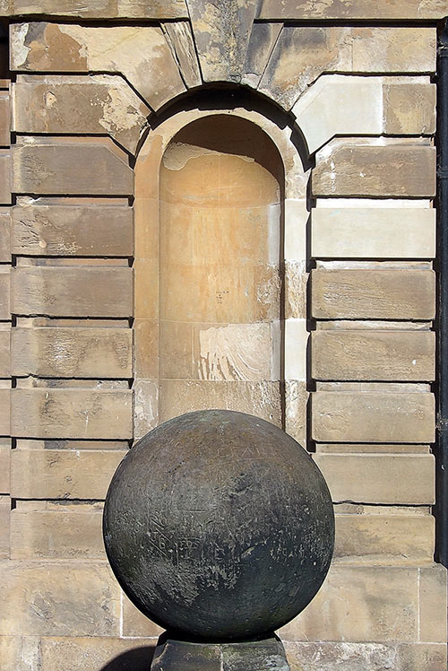
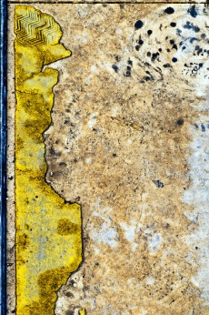
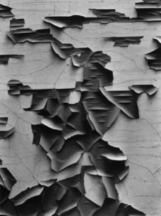
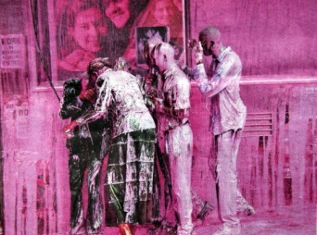
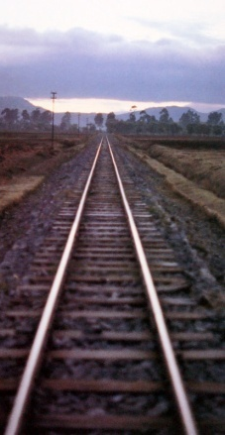
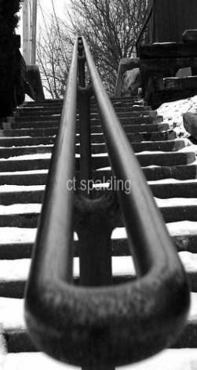
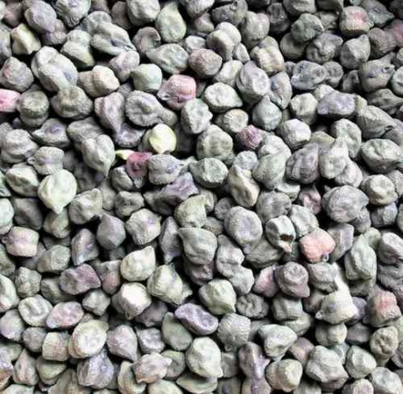
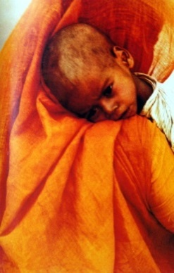
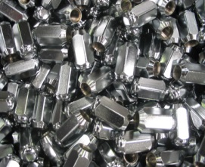
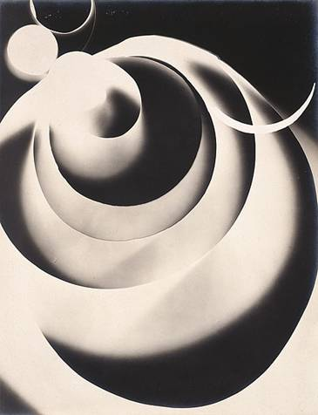
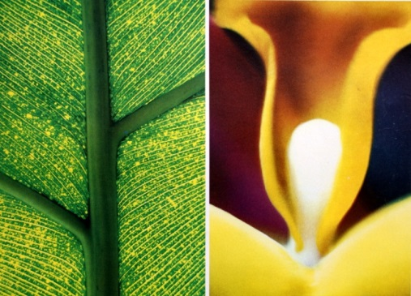
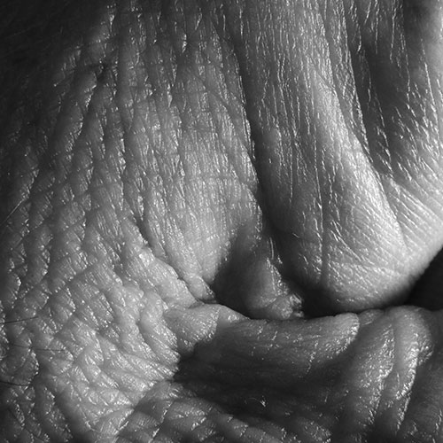
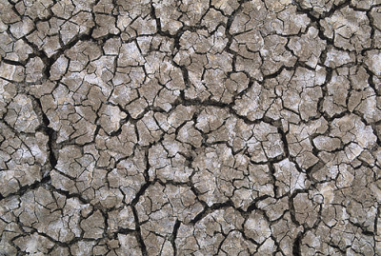
Summer Holiday Homework - VISUAL ELEMENTS due in Sept 1st 2016
LINE
COLOUR
TEXTURE
Lines are seen in photographs in many ways. We see lines as edges of things. We see ‘outlines’ to shapes. We notice that lines appear to lead our eye deep into the photograph. Lines seem to express tension , movement, direction and often create new shapes and patterns.
Task 1: Take at least 10 photos where line is the main visual element.
I will show 3 different lines
1 Straight
2 Diagonal
3 Curved
Imagine a world without colour. We thrive on colour as visual food. It nourishes our senses and contributes to our sense of being truly alive. Photography is now largely colour photography. Colour communicates reality, emotions and stimulates our imagination.
Task 2: Take at least 10 photos where colour is the main visual element.
I will show 3 different colour themes
1 Harmonious
2 Single colour
3 Contrasting colour
Texture is seen mostly on the surface of objects.; rough, spikey, crumbly, nobbly, smooth, gritty are adjectives that we find to describe different surfaces around us. We like to have a variety of textures around us because they stimulate our senses.
Task 3: Take at least 10 photos where texture is the main visual element .
I will show 3 different sources of texture
1 Nature
2 Architecture
3 Detail

Slide 9
Lesson Objective :To be able to collate my research ideas and photographs
Create a new folder in your Large media file storage area – PHOTOGRAPHY
Within Photography create a folder FORMAL ELEMENTS - put the photos you took for homework into a folder marked SUMMER HOMEWORK .
To do that find the SD card or the photos you have emailed in and copy and paste them to the folder.

Slide 10
Set up your website:
Go to the pages and add standard pages and then rename pages so you have the following;
Year 9
Formal elements
Identity
Urban
Externally set task
Move the pages you created in year 9 under the year 9 main page
On the year 9 page insert a text box and type a list of the pages from year 9 – Natural forms, Still life, Alphabet, Portraits, Edges, Our City.
Create a link to these pages with the link symbol

Slide 11
Make the site yours by…
Adding your own photos as headers or background.
Insert a text box on the Home page and write about your interest in photography.
Create interesting titles for the Formal elements page title.

Slide 12
Upload this image from POOL- students- Art- photography- Yr10- formal elements image

Slide 13
.
Create a Title – LINE
Drag in a gallery and upload all of your line photos from your homework
Create a title – COLOUR
Drag in a gallery and upload all of your Colour photos from your homework
Create a title – TEXTURE
Drag in a gallery and upload all of your Texture photos from your homework
Choose the best photo from each section
Open Photoshop and open the 3 best photos

Slide 14
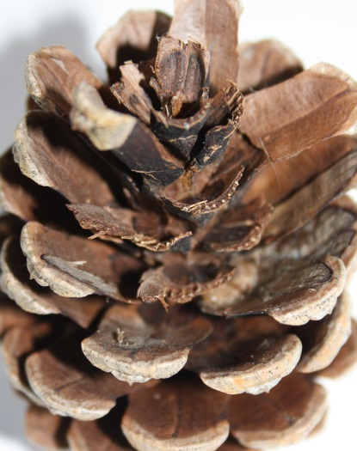
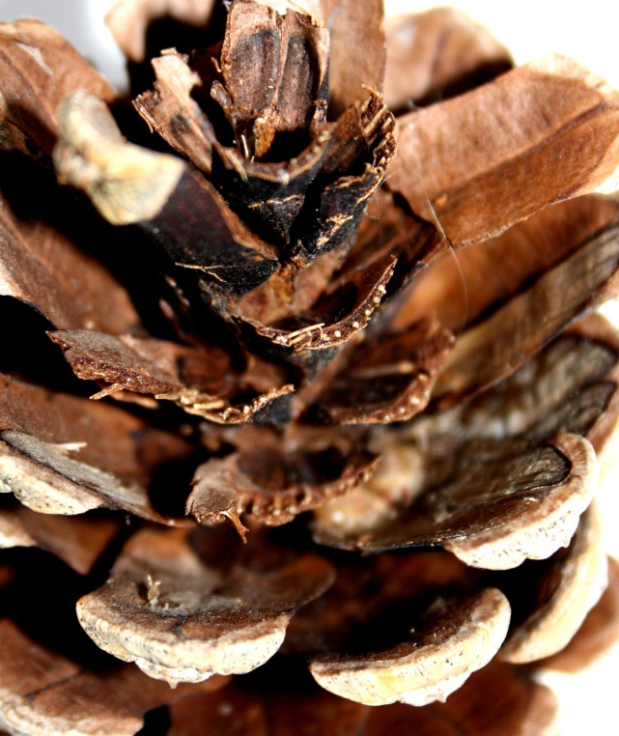
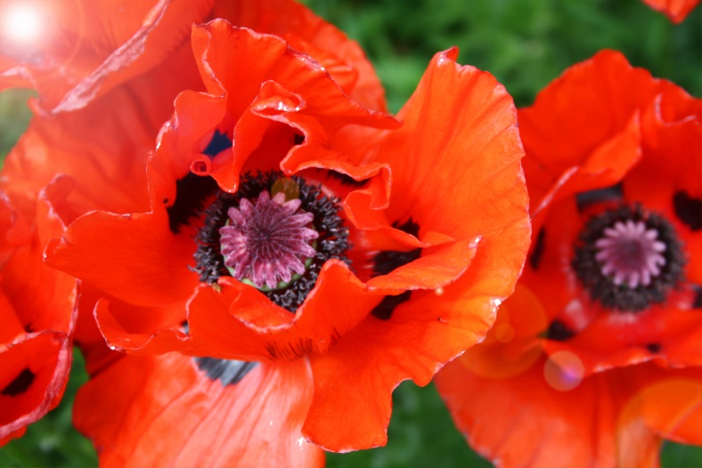
L.O. To be able to edit and refine my photographs using photoshop and the style of other photographers
I am looking for:
Cropping
Monochrome
High colour
Editing that emphasizes LINE, COLOUR and TEXTURE
AO2 – 20 marks
Refine your ideas through experimenting and selecting appropriate resources, media, materials, techniques and processes

Slide 15
Homework
Research Andreas Feininger. Collect 4 images of his close up photographs of nature
Put this in a power point slide and email to yourself or bring on a stick or SD card or come after school to use a school laptop.

Slide 16
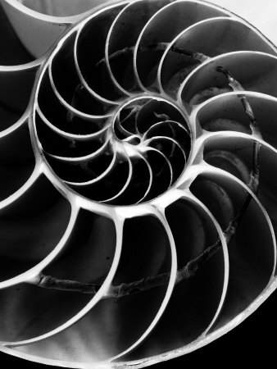
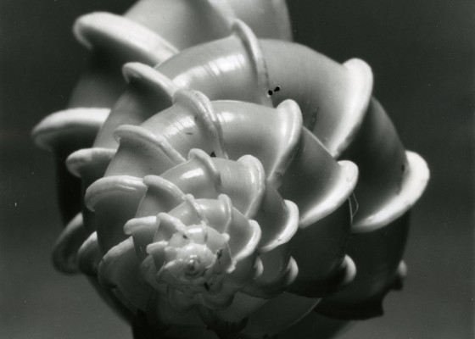
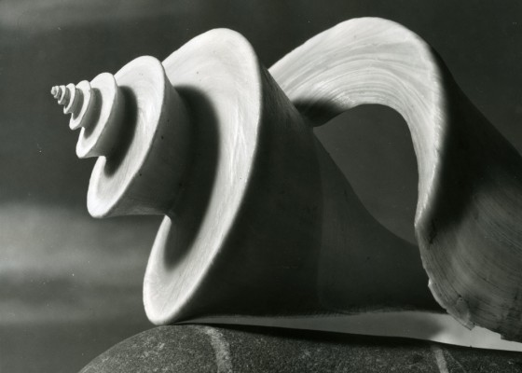
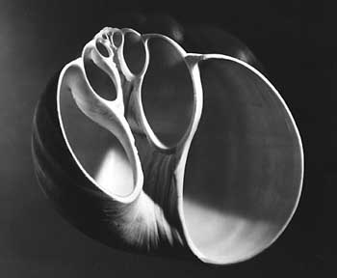
Value and light
Andreas Feininger
emphasis
spirals
tone
form
contrast
shells
composition
abstraction
monochrome

Slide 17
Learning Objective: To be able to comment on the work of a photographer using key words and my opinion.
Write about Feininger’s style and techniques. Use your eyes and the writing frame. Describe what you see and what you like.
Use the writing frame to help you.
Click on 1 of your Feininger images, right click and save as a picture, call it Feininger 1 in your large media file store , still life. Repeat this for the other images, call ing them 2 – 4.
On your website site create a title Andreas Feininger, drag in a slide show and upload the four images
Andreas Feininger photographs of nature captured the beauty of the delicate forms. He used monochrome with high contrast to emphasise the structures and shapes of the objects. He made abstract shapes by magnifying sections of shells and tree bark. His photographs were highly controlled and he used lighting to create shadows and highlights. I particularly like the spirals which he emphasised using strong contrasts. I will use this way of closing in on the structures in my own photography.

Slide 18
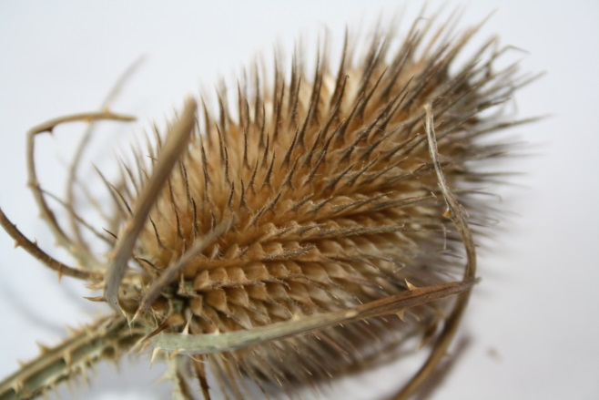
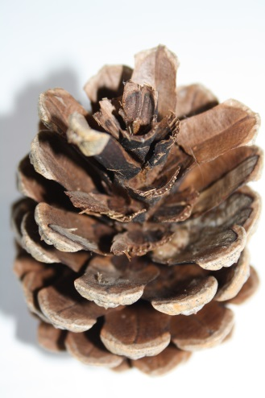
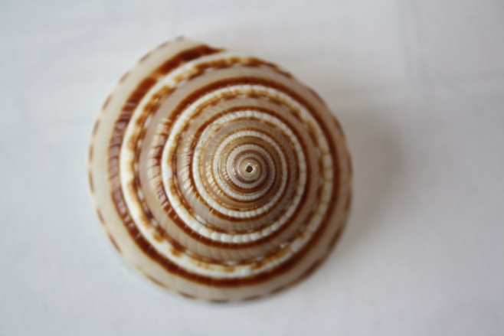
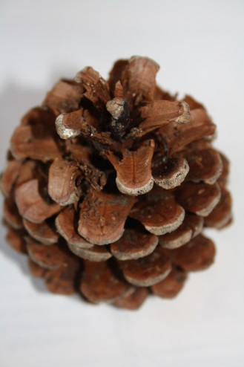
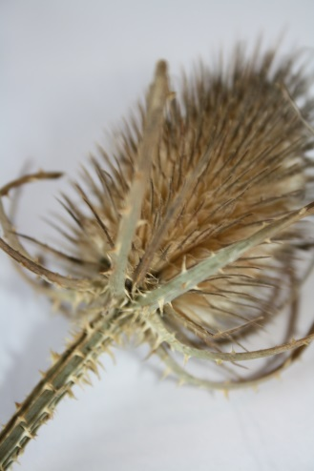
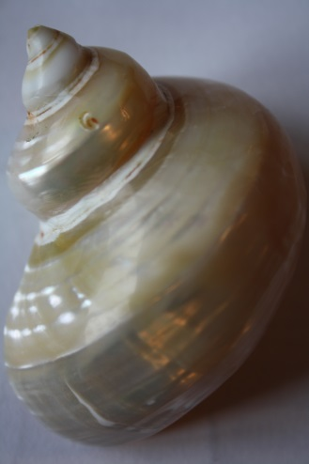
AO1- Understanding, using and developing the work of photographers and artists
Photoshoot :
MY RESPONSE TO ANDREAS FEININGER. Take at least 15 photographs using FEININGER’s style and techniques.
I am looking for:
A close link to Feininger’s style
Shadows
Close up
Clear focus
Clear backgrounds
?
?

Slide 19
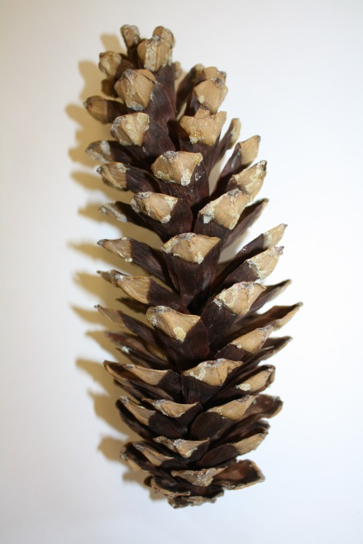
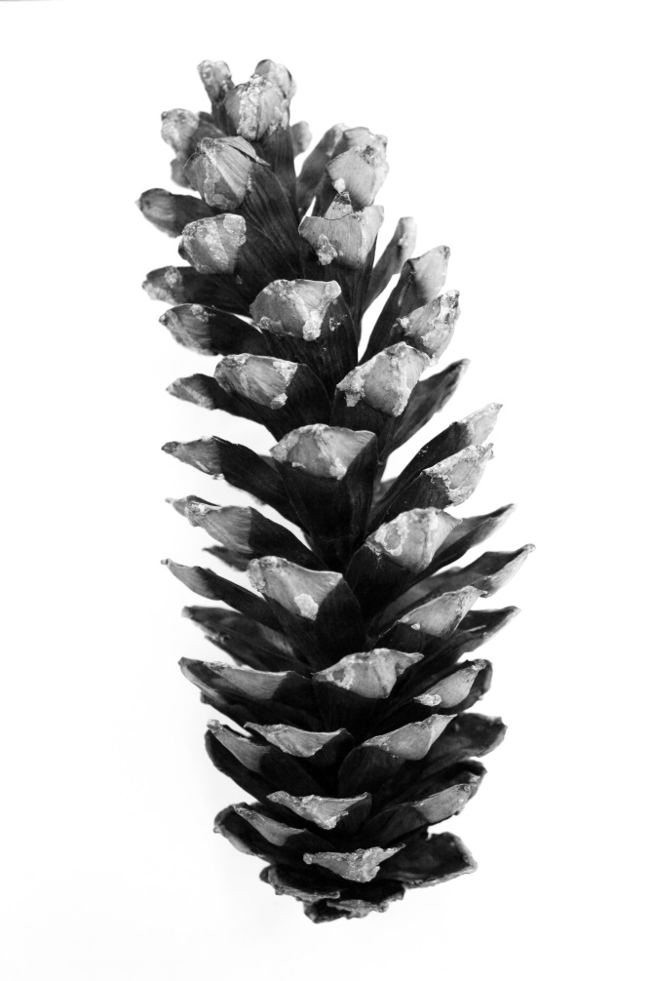
Learning Objective: To be able to response to the techniques of Jan Groover
Present all your Feininger photographs in a gallery, entitled My response to Andreas Feininger
Select the best 4 photos. How can they be improved?
Use some of these editing tools to improve:
Monochrome
Cropping
Increasing contrast – Image-adjustments-brightness/contrast
Upload showing the original next to the edited version. Refining my response to Feininger
AO1- Understanding, using and developing the work of photographers and artists

Slide 20
Homework
Research Victor Schrager. Collect 4 images of his shape photographs of nature
Put this in a power point slide and email to yourself or bring on a stick or SD card or come after school to use a school laptop.
Bring in some plain coloured objects with simple shapes to use in your photoshoot.

Slide 21
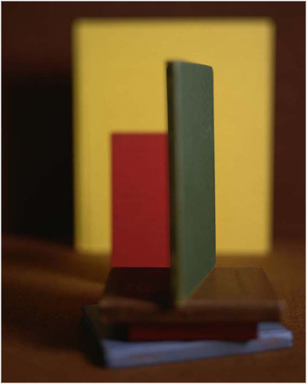
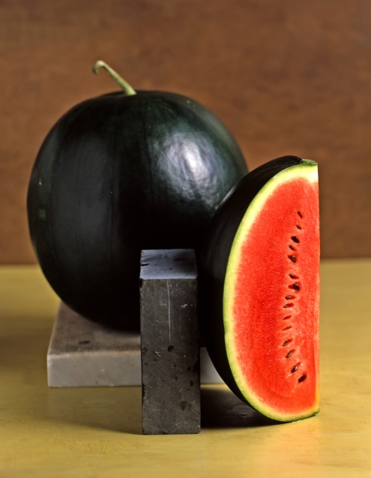
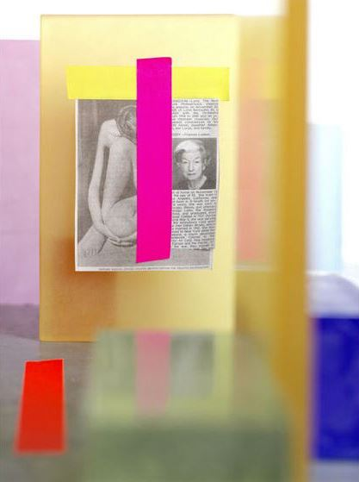
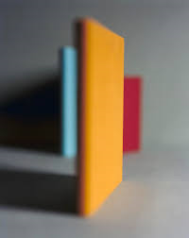
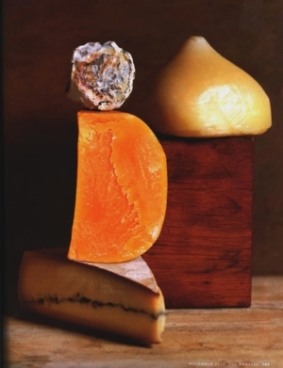
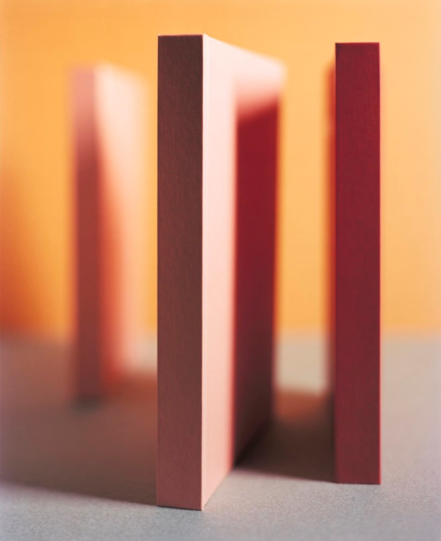
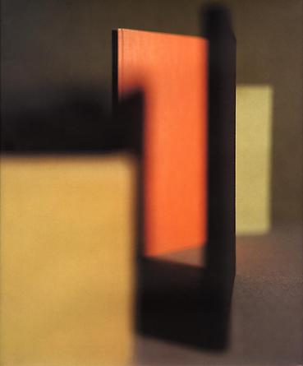
Shape and focus
Victor Schrager
Create a title on your website Victor Schrager. Find 6 images of his shape photographylife and upload to a gallery

Slide 22
Photography analysis word bank
Lesson 2
Visual language – the top 10 things to talk about
Technique | Colour | Composition | Shape | Subject
Light | Media | Mood | Style | Story
Word Bank
Colour | Composition | Mood | Style | Light | Technique | Media
Bright Clashing Cold Contrast Deep Dull Glowing Harmonious Hue Intense Luminous Monochrome Opaque Pale Pure Saturation Transparent Vibrant Warm | Angle Background Blurred Balance Complex Distance Eye line Framing Focus Foreground Form Line Middle ground Movement Near Perspective Scale Space Shape Symmetry Torn Tryptic Thumbnail | Alive Atmospheric Calm Delicate Depressing Dignified Disturbing Fresh Exciting Flamboyant Expressive Humorous Imposing Nostalgic Sad Sentimental Setting Tranquil | Abstract Content Derivative Documentary Distorted Emotional Exaggerated Fake Fantasy Figurative Landscape Religious Repetition Representational Still life Surreal Symbolic Intention Theme | Aperture Aperture priority Artificial Contrast Chroma Dark Develop Exposure Focus Filter Evening Fierce Gentle Harsh Hazy ISO Intense Lens Natural Shady Shadowy Warm | Texture Calibration Digital F-Stop Layered Panorama Pixelization Resolution Solarized Shutter priority Shutter speed Depth of field | Collage Digital Paint Print Photograph Mixed media Photoshop Pixel Noise Film photography Cyanotype Pin hole
You have 3 minutes…….
Underline all the words that relate to Victor Schrager’a photograph

Slide 23
Shape and focus
What common features can you see?
Write as many as you can in your journal.
Victor Schrager

Slide 24
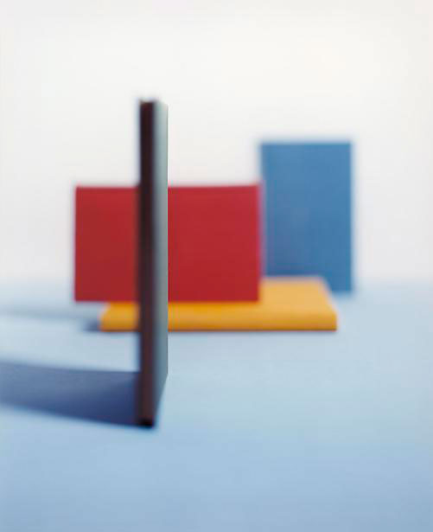
Analyse this photograph using the formal elements. A blank template is in Pool for you.
Light-
Composition-
Repetition-
Focus-
Shape-
Victor Schrager
Mood-
I find this photograph interesting because
I will use the techniques that Schrager has shown by
AO1- Understanding, using and developing the work of photographers and artists

Slide 25
Light- There is strong lighting from the left hand side causing sharp shadows to the left. The whole photograph is brightly lit.
Composition- The books or squares of colour are arranged precisely creating an organised composition. The main features are within the central area of the photograph with a clear border around the edge.
Focus- The whole image if out of focus getting more blurred further away creating depth in the photograph.
Repetition- The right angled corners are repeated and overlapped.
Mood- The orderly arrangement and bold colours make this a strong stark mood. However the out of focus areas create a softer mood.
Shape- The geometric shapes have hard angle and create lots of right angles.
Victor Schrager
I find this photograph interesting because the simple blocks of colours are blurred.
I will use the techniques that Schrager has shown by creating shadows and layered compositions

Slide 26
AO1- Understanding, using and developing the work of photographers and artists
Photoshoot :
MY RESPONSE TO VICTORE SCHRAGER. Take at least 15 photographs using Schrager’s style and techniques.
I am looking for:
A close link to Schrager’s style
Shadows
Close up
Overlapping edges
?
?
?

Slide 27
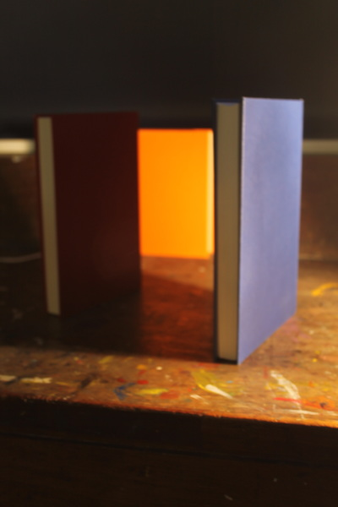
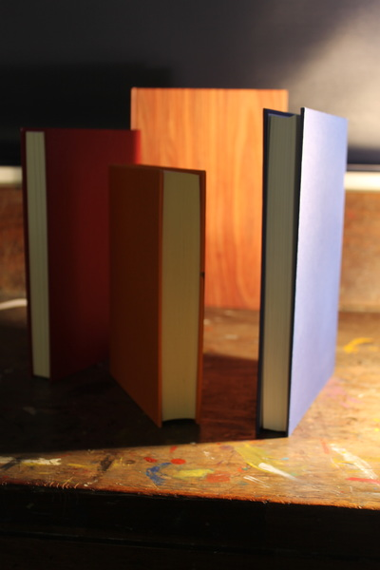
Learning Objective: To be able to response to the techniques of Jan Groover
Present all your Schrager photographs in a gallery, entitled My response to Victor Schrager
Select the best 4 photos. How can they be improved?
Use some of these editing tools to improve:
Cropping
Increasing contrast – Image-adjustments-brightness/contrast
Changing the colour hue– image-adjustments-levels or image-adjustments-hue/saturation-saturation
Upload showing the original next to the edited version. Refining my response to Schrager
Teacher example
AO1- Understanding, using and developing the work of photographers and artists

Slide 28
Line and repetition in architecture
Lesson 1

Slide 29
Your aim is to explore new view points in order to develop the composition of your photographs
Homework 1 –Take 20 photos of new view points in Architecture
How can the camera see a building differently?
How can we look at architecture in a different way?
How can we frame our photographs in a different way?
Put yourself in a different position.
Due

Slide 30
Your aim is to explore new view points in order to develop the composition of your photographs
Homework –Take 20 photos of new view points in Architecture
Homework –Take 20 photos of new view points in Architecture
Your aim is to explore new view points in order to develop the composition of your photographs
How can the camera see a building differently?
How can we look at architecture in a different way?
How can we frame our photographs in a different way?
Put yourself in a different position.
Due Monday 17th October
How can the camera see a building differently?
How can we look at architecture in a different way?
How can we frame our photographs in a different way?
Put yourself in a different position.
Due Monday 17th October
Homework –Take 20 photos of new view points in Architecture
Homework –Take 20 photos of new view points in Architecture
Your aim is to explore new view points in order to develop the composition of your photographs
Your aim is to explore new view points in order to develop the composition of your photographs
How can the camera see a building differently?
How can we look at architecture in a different way?
How can we frame our photographs in a different way?
Put yourself in a different position.
Due Monday 17th October
How can the camera see a building differently?
How can we look at architecture in a different way?
How can we frame our photographs in a different way?
Put yourself in a different position.
Due Monday 17th October

Slide 31
What do these images have in common? As a group of photos how would you describe them?

Slide 32
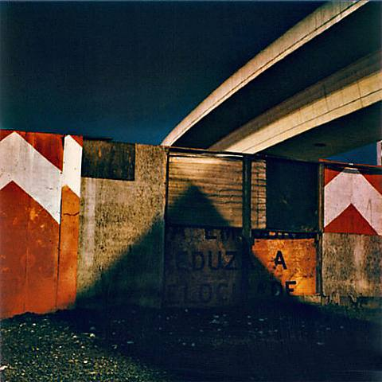
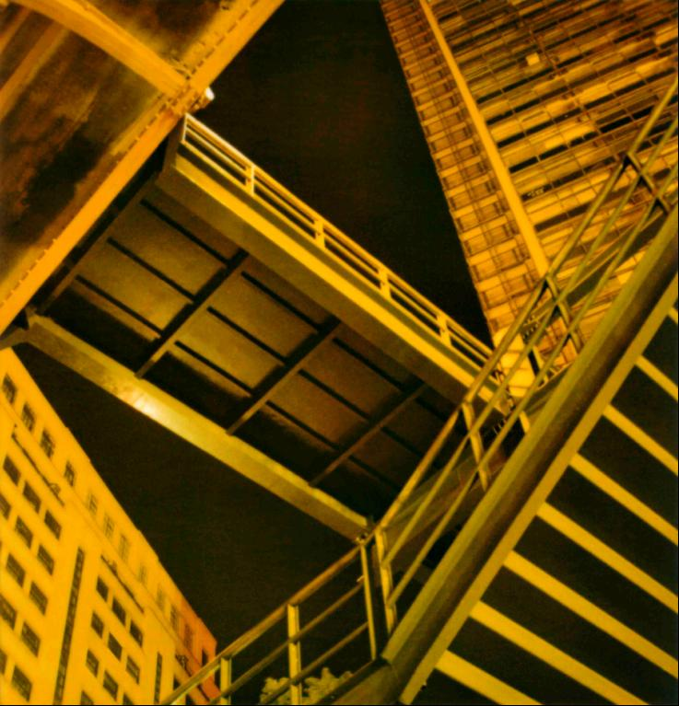
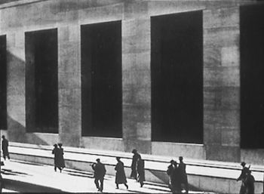
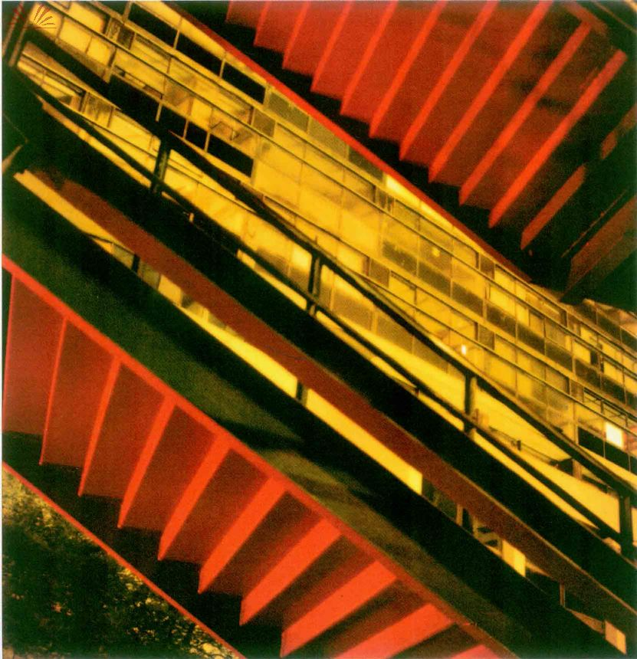
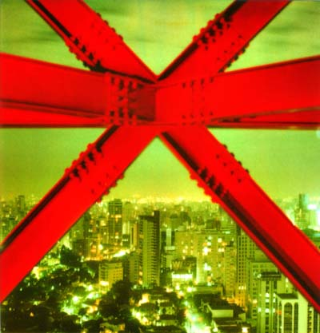
Cassio Vasconcellos
Paul Strand

Slide 33
Photographer’s name
Photographer’s name
Find examples of abstract architecture by these 2 photographers Paul Strand and Cassio Vasconcellos and complete this template.
Photographer’s name
Line and repetition in architecture
Photographer’s name
Photographer’s name
Photographer’s name
Photographer’s name
Photographer’s name

Slide 34
Paul Strand
Paul Strand
Cassio Vasconcellos
Line and repetition in architecture
Paul Strand
Cassio Vasconcellos
Cassio Vasconcellos
Paul Strand
Cassio Vasconcellos

Slide 35
1. Open your website
2. Add a new title – Line and repetition in architecture
3. Make a new file in your large media filestore: Architecture
Upload your completed mind map :
Select all the pics and words - Ctrl A
Right click – save as picture
Save in your large media file store.
Upload to your website

Slide 36
You will need your camera and SD card next lesson

Slide 37
Photoshoot – Line and repetition in Architecture Cropping to show pattern Changing the viewpoint
Learning Objective: To demonstrate using formal elements of line, repetition and shape in abstract architecture

Slide 38
Learning Objective: To demonstrate using formal elements of line, repetition and shape in abstract architecture
Make a new file in your LMFS in the Architecture file called photoshoot 1.
Upload your images from photoshoot 1
Make a new folder called homework 1
Upload your homework images
This will take some time so we will look at the work of Paul Strand while that loads
Lesson 3

Slide 39
Learning Objective: To be able to comment on the work of a photographer using key words and my opinion.
Write about this photograph using each of the formal elements
If this photograph could talk, what story would it tell?

Slide 40
Light-
Composition-
Focus-
Line-
Contrast-
Colour-
Paul Strand
Mood-
Shape-
I find this photograph interesting because
I will use the techniques by

Slide 41
Homework 2
Research Paul Strand. Collect 4 images of his close up photographs of architecture
Upload these onto your website.
Due in

Slide 42
Learning Objective: To demonstrate using formal elements of line, repetition and shape in abstract architecture
On your website make a title : Viewpoints in architecture,
Drag in a gallery and upload your images from your homework.
Make the gallery 5 columns, the image ratio ‘none’.
Title: my top 5
Upload, as separate images, the best 5 that show an unusual and interesting viewpoint. Write how the formal elements have been used in these.
Lesson 4

Slide 43
Learning Objective: To demonstrate using formal elements of line, repetition and shape in abstract architecture
Make a title : Line and repetition in architecture,
Drag in a gallery and upload your images from photoshoot 1.
Make the gallery 5 columns, the image ratio ‘none’.
Title: My top 5
Upload, a separate images, the best 5 that show line, shape and repetition. Write how the formal elements have been used in these.
Lesson 5

Slide 44
Learning Objective: To be able to comment on the work of a photographer using key words and my opinion.
Upload your analysis of Strand photo.
Write about Strand’s style and techniques. Use your eyes and the writing frame. Describe what you see and what you like.
Use the writing frame to help you.
Paul Strand’s photographs of architecture captured the strength and structures in the city environment. He used monochrome with high contrast to emphasise the lines and shapes of the buildings. He noticed the shapes formed by the shadows and highlights and based his composition around these features I particularly like the shapes in stairways which he emphasised using strong contrasts. I will use this way of closing in on the structures in my own photography.
Lesson 6

Slide 45
Learning Objective: To demonstrate formal elements of photography
To be able to manipulate your photograph to show an influence from Paul Strand
My response to Paul Strand
Open your image in photoshop.
How can you make the line, shape and repetition more dominant?
Edit your images
Save each stage so you can then write why you have edited.
Upload as an image your website
Add a text box for each stage
Lesson 6&7

Slide 46
Homework
Research Cassio Vasconcellos. Collect 4 images of his close up photographs of architecture
Upload these onto your website.
Upload your favourite Vasconcellos photo and write about why you like it. Remember to use the formal elements and key words in your writing.
There is an example on the ush website to help you www.ushphotographygcse.weebly.com
Due in

Slide 47
D
Describe
E
Elements
E
Emotion
P
Point of view
Describe what you see in the photo.
What is it a photo of?
When was the photo taken?
Where was the photo taken? Why was the photo taken?
Which of the formal elements have been used? How/ why have they been used?
How does the photo make you feel?
Why?
Would all viewers feel the same?
Do you like/dislike the photo– Why?
-How does it link to your work?
-How might it influence your work?
Compare it to other images.

Slide 48
Learning Objective: To be able to comment on the work of a photographer using key words and my opinion.
Write about your favourite photograph using each of the formal elements
If this photograph could talk, what story would it tell?
Lesson 8

Slide 49
Light-
Composition-
Focus-
Line-
Contrast-
Colour-
Cassio Vasconcellos
Mood-
Shape-
I find this photograph interesting because
I will use the techniques by

Slide 50
You will need your camera and SD card next lesson

Slide 51
Photoshoot :
Looking for colour, repetition and shape.
Photoshoot :
Looking for colour, repetition and shape.
Look for :
Shapes, Lines, Colours, Shadows
Remember to put yourself in the right place.
Will the photo show symmetry?
Which shapes repeat?
Look for :
Shapes, Lines, Colours, Shadows
Remember to put yourself in the right place.
Will the photo show symmetry?
Which shapes repeat?

Slide 52
Learning Objective: To demonstrate using formal elements of line, repetition and shape in abstract architecture
Make a new file in your LMFS in the Architecture file called photoshoot 2. Upload your images from photoshoot 2
This will take some time so we will look at the using collage while that loads.
Lesson 11

Slide 53
Learning Objective: To demonstrate formal elements of shape, line and repetition.
To be able to manipulate your photograph to show an influence from Cassio Vasconcellos
Cut and stick these into a new composition
I am looking for:
Neat cutting
A clear link to Cassio Vasconcellos
Repeated shape
Repeated lines

Slide 54
Homework 4 -
Identify your top 5 photos from the photoshoot and upload these to your website.
Write a description of why each one is successful and what you would want to change about that photograph.

Slide 55
Learning Objective: To demonstrate using formal elements of line, repetition and shape in abstract architecture
In website make a title : My response to Vasconcellos,
Drag in a gallery and upload your images from photoshoot 2.
Make the gallery 5 columns, the image ratio ‘none’.
Title: my top 5
Upload, as separate images, the best 5 that show line, shape and repetition. Write how the formal elements have been used in these.
This will take some time so continue with your collage while that loads.
Lesson 12

Slide 56
Learning Objective: To demonstrate formal elements of photography
To be able to manipulate your photograph to show an influence from Cassio Vasconcellos
Refining my response to Vasconcellos
Open your image in photoshop.
How can you make the pattern and colour more dominant?
Edit your images
Save each stage so you can then write why you have edited.
Upload as an image on weebly
Add a text box for each stage
Lesson 13

Slide 57
Learning Objective: To demonstrate formal elements of shape, line and repetition.
To be able to manipulate your photograph to show an influence from Cassio Vasconcellos
Cut and stick your photographs into a new composition
I am looking for:
Neat cutting
A clear link to Cassio Vasconcellos
Repeated shape
Repeated lines

Slide 58
Homework
Research Laura Letinsky. Collect 4 images of her still life photographs of nature
Upload these onto your weebly site.
Upload you favourite Letinsky photo and write about why you like it. Remember to use the formal elements and key words in your writing.
There is an example on the ush website to help you www.ushphotographygcse.weebly.com
Due in 13th October

Slide 59
Formal elements in a composition
Laura Letinsky

Slide 60
Learning Objective: To be able to comment on the work of a photographer using key words and my opinion.
Laura Letinsky
Create a title on your website Formal Elements in a composition
Laura Letinsky.
Upload your homework images into a gallery.

Slide 61
Learning Objective: To be able to analyse the composition of a photograph using rule of thirds.

Slide 62
The Rule of Thirds grid
Learning Objective: To be able to analyse the composition of a photograph using rule of thirds.
The rule of thirds is a compositional device that suggests your photographs will look better if you place the main subject off centre within the frame. Most digital cameras have a rule of thirds grid that can be overlaid on the viewfinder. The idea is that when you are composing your image, you use the grid as a guide to position the elements.
Notice how the horizon is positioned on the top grid line and the house sits at an intersection point.

Slide 63
Historical Context
Learning Objective: To be able to analyse the composition of a photograph using rule of thirds.
The rule of thirds is a simplified version of the golden ratio, a classical compositional aid that is found in nature.
Artists throughout history have looked for ways to assist them in composing their images.
Although we call it the Rule of Thirds it is more of a guide. By taking photographs that are divided into three sections you create images that are more visually interesting.

Slide 64
Some Examples
Learning Objective: To be able to analyse the composition of a photograph using rule of thirds.

Slide 65
Another Example
Learning Objective: To be able to analyse a photograph using rule of thirds.
The photo above shows the corridor taken from a ‘standard’ standing position. Although quite good, by re-composing the image using the rule of thirds grid, a much more dynamic and visually interesting image is made.

Slide 66
Learning Objective: To be able to analyse the composition of a photograph using rule of thirds.

Slide 67
Learning Objective: To be able to analyse a photograph using the formal elements.
Draw on your photo labelling where the formal elements have been used. Comment on why and how these elements have been used.

Slide 68
Light-
Composition-
Focus-
Line-
Contrast-
Colour-
Laura Letinsky
Mood-
Shape-
I find this photograph interesting because
I will use the techniques by

Slide 69
D
Describe
E
Elements
E
Emotion
P
Point of view

Slide 70
D
Describe
E
Elements
E
Emotion
P
Point of view
Describe what you see in the photo.
What is it a photo of?
When was the photo taken?
Where was the photo taken? Why was the photo taken?
Which of the formal elements have been used? How/ why have they been used?
How does the photo make you feel?
Why?
Would all viewers feel the same?
Do you like/dislike the photo– Why?
-How does it link to your work?
-How might it influence your work?
Compare it to other images.

Slide 71
Learning Objective: To be able to comment on the work of a photographer using key words and my opinion.
Upload you favourite Letinsky photo and write about why you like it. Remember to use the formal elements and key words in your writing.
My favourite Laura Letinsky image This is my favourite image of Laura Letinsky's, I like the clean fresh colours against the plain white cloth and white plates. These colours are warm and pastel creating a pleasant happy mood. I like this image because Letinsky has used circles and semi circles that repeat getting smaller and smaller drawing you to the centre of the photograph. Letinsky has used lighting to keep the still life looking fresh and natural so there are few shadows. She has continued with her theme of 'how the table looks at the end of a meal‘; I imagine this to be taken at a summer party or wedding because of the fruit and bright colours. I

Slide 72
Learning Objective: To be able to plan your photoshoot effectively
Create 4 outline thumbnail drawings to plan your composition for your photoshoot. I am looking for:
Rule of thirds
Source of light
Links to Laura Letinsky
Links to Renger Patzch

Slide 73
Learning Objective: To be able to edit and refine your photos effectively.
Edit your images using cropping and levels.
Take screen shots as you go and save in a ppoint or a separate images so you can present this on your website

Slide 74
Printable worksheets

Slide 76
Paul Strand’s photographs of …………. captured the strength and structures in the city environment. He used ………………….. with high contrast to emphasise the …….............and …………………………..of the buildings. He noticed the patterns formed by the ………………..and highlights and based his composition around these features. I particularly like ……………………………………………………..
I will use …………………………………………………….
……………………………………………………………………
in my own photography.
lines , architecture, shapes , monochrome , shadows
Paul Strand’s photographs of …………. captured the strength and structures in the city environment. He used ………………….. with high contrast to emphasise the …….............and …………………………..of the buildings. He noticed the patterns formed by the ………………..and highlights and based his composition around these features. I particularly like ……………………………………………………..
I will use …………………………………………………….
……………………………………………………………………
in my own photography.
lines , architecture, shapes , monochrome , shadows

Slide 78
Photoshoot 2:
Looking for colour, repetition and shape.
Photoshoot 2:
Looking for colour, repetition and shape.
Look for :
Shapes, Lines, Colours, Shadows
Remember to put yourself in the right place.
Will the photo show symmetry?
What shape repeat?
Look for :
Shapes, Lines, Colours, Shadows
Remember to put yourself in the right place.
Will the photo show symmetry?
What shape repeat?

