Slide 1
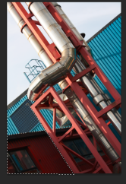
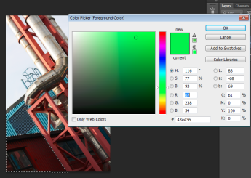
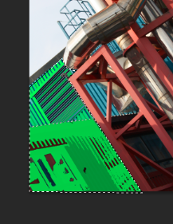
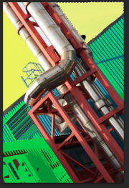
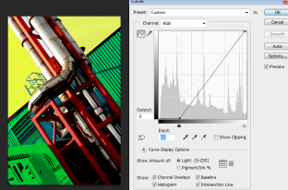
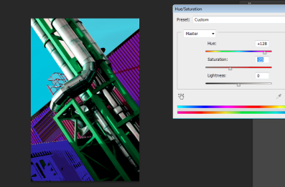
Select the polygon lasso tool and draw round an area where you want to change the colour. Complete the shape so you get matching ants round it.
Select the paint bucket tool. Click on the top colour and select from the rainbow the colour you want, OK.
Change the opacity to around 50%. Fill the shape by clicking on areas. If you fill too much look at you history in the View menu and go back .
Save as a jpeg as stage 1 now
Repeat the process filling with as much colour as you want.
Save as a jpeg as stage 2 now
Image –adjustments –curves. Vary the intensity of the colour by moving the arrows on the graph along
Save as a jpeg as stage 3 now
Image – adjustment – hue/saturation .
Vary the hue and saturation to create a new version. Go for a colour scheme that relates to the photographer
Save as a jpeg as stage 4 now
Repeat the process and any variations you want to try out.

